Slide 1
NDN (Named Data Networking)
Presenter: Chelsea

Slide 2
Outline
What is NDN?
Why we need NDN?
NDN architecture and packet format
How does NDN work?
Summary
Reference

Slide 3
NDN (Named Data Networking)
It is one of five projects funded by the U.S. National Science Foundation under its Future Internet Architecture Program.
It has its roots in an earlier project, Content-Centric Networking(CCN).
CCN was first publicly presented in 2006 by Van Jacobson.
The evolution from today’s host-centric network architecture to a data-centric network architecture.
IP(Internet protocol)
NDN
host-centric network architecture
data-centric network architecture

Slide 4
Why we need NDN?
Nowadays networking is based on TCP/IP
Advantage :
TCP/IP packets named only communication endpoints.
Disadvantage :
Security
Flexibility
Broadcast

Slide 5
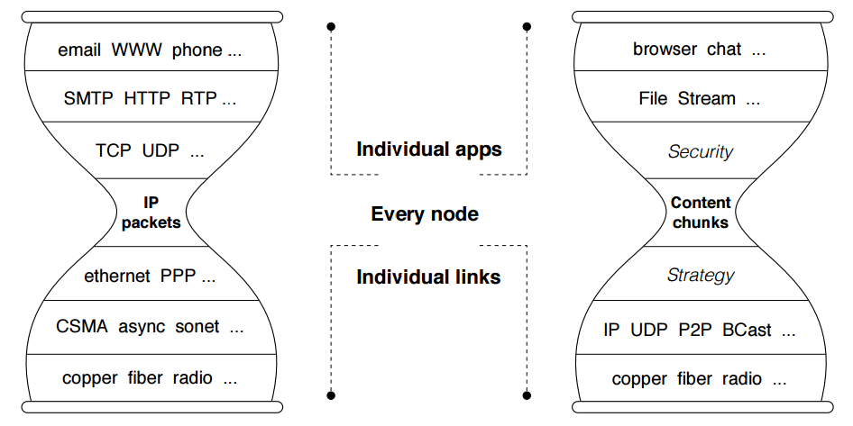
NDN Architecture
IP architecture
NDN architecture
Notes:
The main building blocks of NDN architecture are named content chunks, in contrast to the IP architecture’s fundament unit of communication, which is and end-to-end channel between two endpoints identifiered by IP address

Slide 6
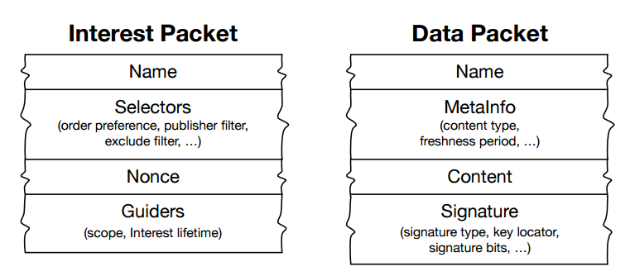
NDN packet format
Notes:
Packets in NDN architecture

Slide 7
Content Naming
Names are generated by application
Hierarchical – identify content relationship and facilitate aggregation
Every data packets carried a signature, binding name to the content
NCNU-CSIE/videos/badminton/1(version)/2(segment)
Routed name
application
Application instance

Slide 8
What components are in NDN router?
To carry out the Interest and Data packet forwarding function, each NDN router maintains three data structures and a module :
PIT ( Pending Information Table)
FIB (Forwarding Information Base)
CS (Content Store)
Forwarding Strategy module

Slide 9
Forwarding process at an NDN node
Interest
forward
CS
PIT
FIB
Request A
Data
Add incoming interface
Data producer
Notes:
Forwarding process at an NDN node

Slide 10
Forwarding process at an NDN node
CS
Data
forward
PIT
Request A
Data producer
Remove entry
Notes:
Forwarding process at an NDN node

Slide 11
Forwarding process in NDN
NDN Router
Request A
CS
PIT
Data producer
Request B
Interest packet
Data packet

Slide 12
Forwarding process in NDN
NDN Router
Request A
Data producer
CS
Request B
Interest packet
Data packet

Slide 13
Forwarding process in NDN
NDN Router
Request A
Data producer
Request B
Interest packet
Data packet

Slide 14
Nowadays Networking
Data producer

Slide 15
Named Data Networking
Data producer

Slide 16
Summary
 | NDN | TCP/IP
completely transmission | 2 packets (Not connection based) | 9 packets (Connection based)
Security | Great | Bad
Routing and forwarding problem | Matching integers is much faster | Insufficient IP address NAT traversal Mobility Wasting of resource
NCE
(Name Component Encoding)

Slide 17
Questions and Comment

Slide 18
Reference
Named Data Networking architecture
L. Zhang, A. Afanawyev, J. Burke, V. Jacobson, K. Claffy, P. Crowley et al., “Named Data Networking,” ACM SIGCOMM Computer Communication Review, Vol. 44, No. 3, July 2014.
Named Data Networking Test-bed
Quickly understand NDN by video
Introduction NDN by Van Jacobson

