Slide 1
The Mountain Climbing Integration System Base on LoRaWAN& Raspberry Pi
Presenter: Jonathan& Mini

Slide 2
Outline
Why select this topic?
How does it work?
Demo
Our system future

Slide 3
Why select this topic?
When we climb mountain, the leader have to pay attention to everyone, and this time we can use something to get everyone position.
If we can get everyone position on fixation time, it will be safer when climbing mountain.

Slide 4
How does it work?
Team member’s position?
Get position

Slide 5
Demo

Slide 6
Get GPS information by Python

Slide 7
Display on LoRa server database

Slide 8
Show position on Google map by Google map API

Slide 9
Node to Node Transfer Data
Arduino Transmitter
LoRa Receiver connect to PC

Slide 10
Node to Node Transfer Data –Cont.
Arduino Receiver
LoRa Transmitter on PC

Slide 11
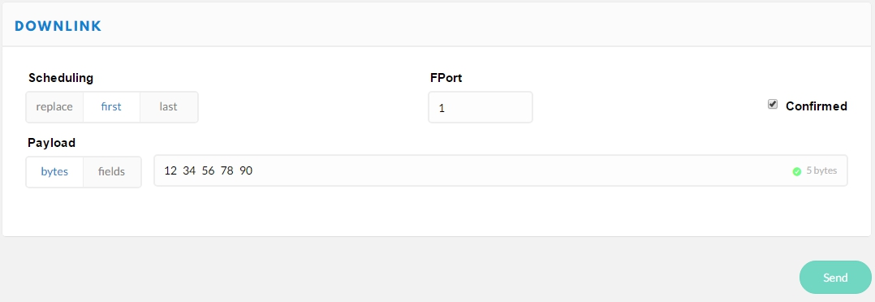
Server Downlink to LoRa module
TTN downlink the data 1234567890
LoRa node receive the data 1234567890

Slide 12
Our system future
Member node to member node
All member nodes send message one by one and finally arrive to leader node.
Voice over LoRa
Gateway send message to node

