Slide 1
Quick UDP Internet Connections
Nicole

Slide 2
Overview
What is QUIC
What is SPDY
Advantages of QUIC
Establishing a QUIC Connection
QUIC Performance
Conclusion

Slide 3
What is QUIC
QUIC is an experimental transport layer network protocol designed by Google
Reliable stream transport over UDP
QUIC is functionally equivalent to TCP+TLS+HTTP/2
Notes:
QUIC is very similar to TCP+TLS+HTTP2, but implemented on top of UDP

Slide 4
What is SPDY(speedy)
Multiple HTTP request on one TCP socket
Compress HTTP headers
Server Push
Prioritization among parallel request
Notes:
head-of-line blocking
One packet loss affect all stream
3 way hand shake (tcp =1.5 rtt,ssl = 3rtt)
Single congestion window

Slide 5
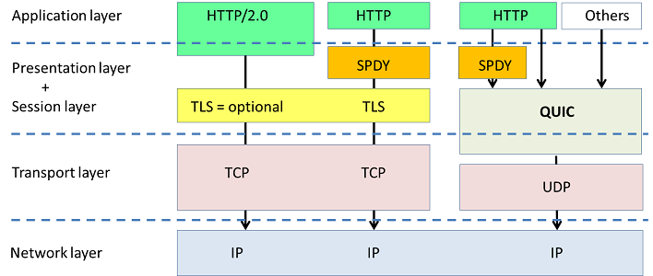
Where does QUIC fit in?
Notes:
Congestion control, encryption, and some HTTP/2 move to QUIC

Slide 6
Advantages of QUIC
Connection establishment latency
Pluggable congestion control
Multiplexing without head-of-line blocking
Authenticated and encrypted header and payload
Stream and connection flow control
Connection migration
Protocol is pushed into application space (unlike TCP which is handled in kernel)
FEC(Forward error correction)

Slide 7
Establishing a QUIC Connection
Client sends an inchoate (empty) client hello (CHLO)
Server sends a rejection (REJ)
Client establishes QUIC connection in the background
Client’s can cache if server supports QUIC
CHLO
REJ
Data

Slide 8
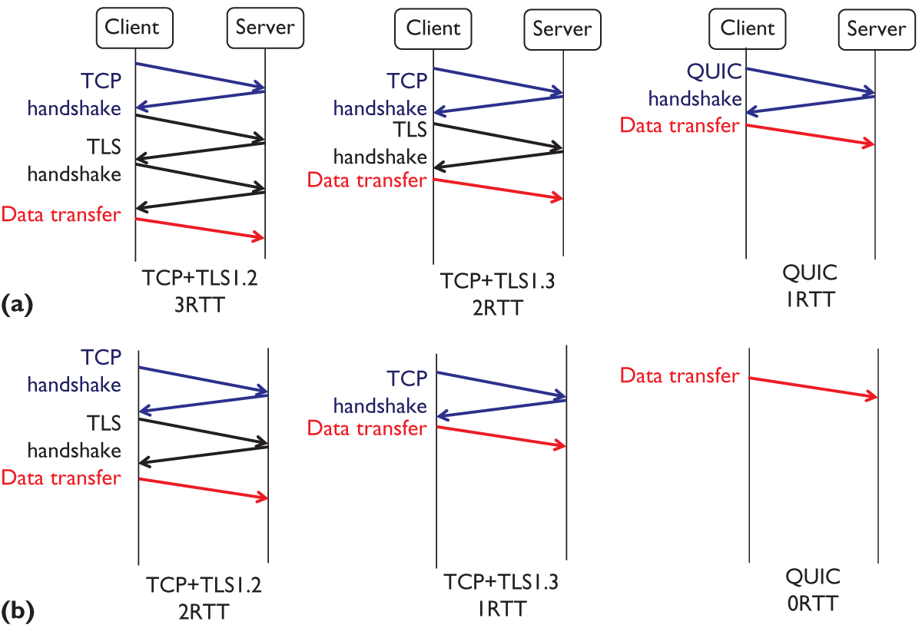
Connection Establishment Latency

Slide 9
Flexible Congestion Control
QUIC provide richer information to congestion control algorithms than TCP.
One example of richer information is that each packet, both original and retransmitted, carries a new packet sequence number.

Slide 10
Flow Control
Client and server
Connection and streams
Credit based
  Default 64KB – clients and server normally set this higher
  Requires updates by WINDOW_UPDATE frame

Slide 11
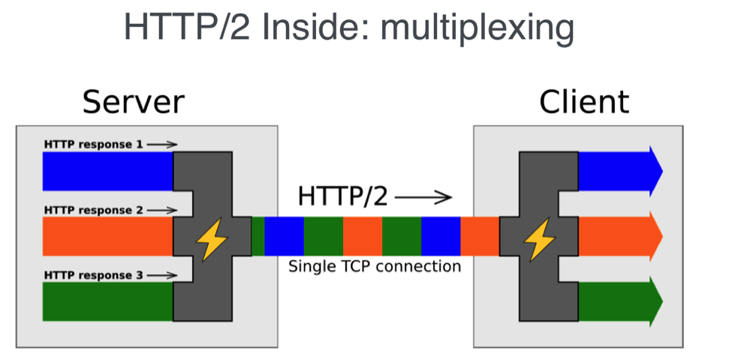
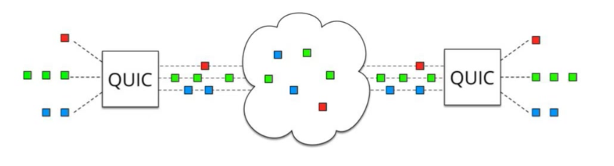
Multiplexing
HTTP/1.1
  4-8 outstanding requests on 4-8 connections
  Resource intensive on the server
HTTP/2 and QUIC
  One connection, many concurrent requests
  Normally limited to 100

Slide 12
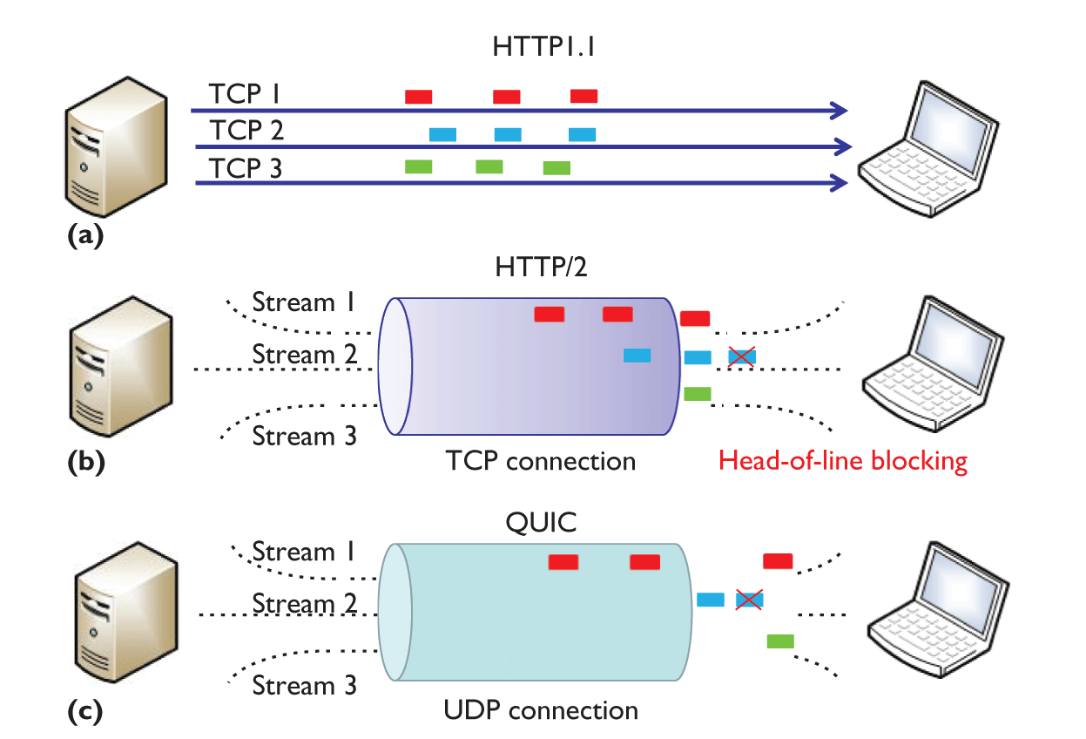
Multiplexing

Slide 13
Authenticated and Encrypted Header and Payload
QUIC packets are always authenticated and typically the payload is fully encrypted. The parts of the packet header which are not encrypted are still authenticated by the receiver, so as to thwart any packet injection or manipulation by third parties.
Caveat: PUBLIC_RESET packets that reset a connection are currently not authenticated.

Slide 14
Connection Migration
TCP connections are identified by a 4-tuple of source address, source port, destination address and destination port.
QUIC connections are identified by a 64-bit Connection ID, randomly generated by the client..

Slide 15
Prioritization
Ability for clients to set a priority of a stream
Dependency tree for streams
Higher weights get more resources
Resources proportional to the weighting

Slide 16
QUIC Potential Issues
UDP rate limiting and blocking
More CPU usage on client and server
DOS attacks

Slide 17
Reference
google QUIC
https://www.chromium.org/quic
http://technews.tw/2015/04/20/google-quic-tcp-udp/
https://read01.com/e4Ny5K.html

