Slide 1
Let’s ChronoSync: Decentralized Dataset State Synchronization in Named Data Networking
IEEE ICNP 2013
Zhenkai Zhu and Alexander Afanasyev
University of California, Los Angeles
Notes:
IEEE International Conference on Network Protocols

Slide 2
Outline
Introduction of this paper
NDN architecture
ChronoSync Design
Evaluation
Conclusion

Slide 3
Introduction
Synchronization in applications play an important role in our daily life.
File sharing
Group text messaging
Collaborative editing
….Etc.
Quite a few popular applications have their way to synchronize dataset:
Dropbox and Google Docs : Centralization
BitTorrent Sync service : Peer-to-Peer
ChronoChat : based on ChronoSync protocol in Named Data Networking(NDN)

Slide 4
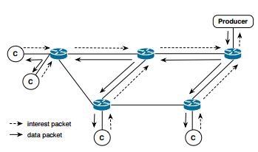
NDN architecture
Two basic communication units : interest packet and data packet.
All communication in NDN is receiver-driven.
Pending Interest Table (PIT) : recording the interface which sent interest packet.
PIT mechanism makes multicast be naturally supported in NDN.

Slide 5
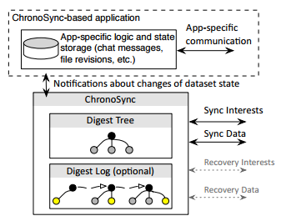
ChronoSync overview
Two interdependent components of ChronoSync-based application :
The application logic module : Respond to the change of the dataset state.
ChronoSync module : Synchronize the state of the dataset.
Notes:
State of the dataset

Slide 6
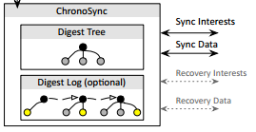
ChronoSync overview (cont.)
ChronoSync encodes the state of dataset into a crypto form( e.g. SHA256 ), this form we call the state digest, or digest in short.
In ChronoChat , ChronoSync module maintains the current user’s messages in digest tree , as well as history of the dataset state changes in digest log.
Notes:
Digest tree

Slide 7
Naming rules of ChronoSync
Prefix
The application name and the chatroom name.
(3) Sequence number
Prefix in broadcast namespace for a given broadcast domain.
The application name and the chatroom name.
The latest state digest of the interest sender.
Notes:
Prefix is just like route table
(2) To identify the process that is responsible for handling such interest.

Slide 8
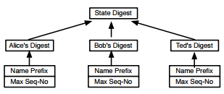
Maintaining dataset state
Each child node of the tree root holds a cryptographic digest calculated by applying hash function over a user’s producer status.
Whenever a ChronoChat user sends or learns messages , the corresponding branch of the digest tree is updated and the state digest is re-calculated.

Slide 9
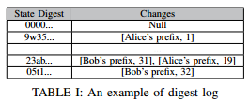
Maintaining dataset state (cont.)
Each party keeps a digest log along with the digest tree.
This log is a list of key-value pairs arranged in chronological order , where the key is the state digest and the value field contains the producer status.

Slide 10
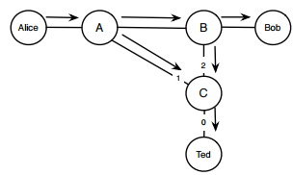
Propagating dataset changes – an example
When Alice sends a text to the chatroom, ChronoSync module on her machine immediately notice that its state digest is newer and hence proceeds to satisfy the sync interest with sync data.
Whoever receives the sync data updates the digest tree and sends out a new sync interest with the updated state digest.
Ted’s sync interest may reach Bob before he receives Alice’s sync data..
Sync data
Wait timer Tw
Sync interest
Notes:
Tw : propagation delay.
To cope with this problem, ChronoSync employs a randomized wait timer Tw, with value being set approximately on the order of the propagation delay.
In the example, Bob’s state digest would become the same as the new digest after Alice’s reply reaches him, before Tw expires.

Slide 11
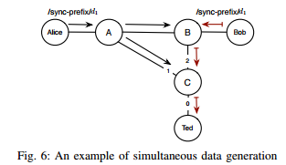
Handling simultaneous data generations
When the wait time Tw times out, Ted proceed to send a sync interest with the previous state digest again, but this time with an exclude filter that contains the hash of Bob’s sync data.
Routers understand that Bob’s sync data cannot be used as the reply to the interest.
Wait Tw and send sync interest again
Notes:
- Exclude filter 的lifetime非常短，因為他是為了要synchronize data，若data存在，就應該早就在Router的cache裡面。(Wait Tw的目的就是為了等Data到Router)
- Exclude filter : One of the selectors that can be sent along with the interest to exclude data that the requester no longer needs.
- 若同時有很多data到達Router, 目前只能等很多次Tw times out, 再一次一次透過exclude filter把data 個別拿回來

Slide 12
Handling network partitions
When the interest with exclude filter times out, ChronoSync infers that the network partitions have happened.
The recipient of the unknown digest sends out a recovery interest.
Those who recognize the digest (e.g. having it in their digest log) reply the recovery interest with the most recent producer status of all users.
Notes:
- Exclude filter 的lifetime非常短，因為他是為了要synchronize data，若data存在，就應該早就在Router的cache裡面。(Wait Tw的目的就是為了等Data到Router)

Slide 13
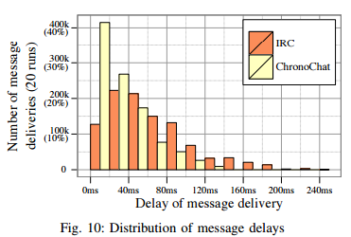
Evaluation : IRC vs ChronoChat
IRC : Internet Relay Chat service, based on TCP/IP.
(1) Performance under normal network condition :
Notes:
ChronoChat 整體的 Delay 較小

Slide 14
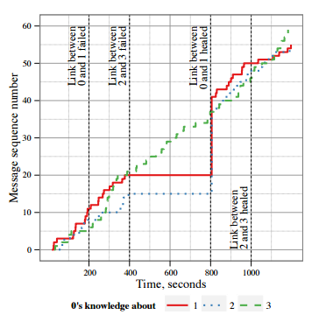
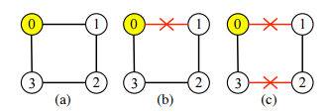
Evaluation
(b)
(c)
(2) Synchronization resiliency to network failures:

Slide 15
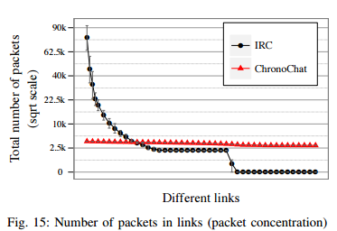
Evaluation : IRC vs ChronoChat
(3) Network utilization pattern
ChronoChat : More or less equally utilizes all of the available network links between participants.
IRC : A few links close to the server have high packet concentrations.

Slide 16
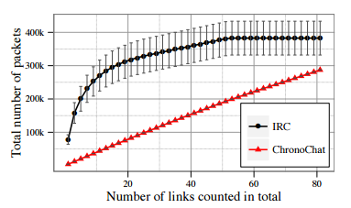
Evaluation : IRC vs ChronoChat
(4) Overall overhead

Slide 17
Conclusion
ChronoSync is a decentralized dataset synchronization protocol for distributed application running in NDN.
This protocol removes both single point of failure and traffic concentration problems common associate with centralized implementations.
ChronoSync is highly robust in faces of network partitions.

