Slide 1
ACT:Audio Conference Tool Over Named Data Networking(NDN)
Authors: Zhenkai Zhu UCLA, Los Angeles, CA, USA
Sen Wang Tsinghua University, Beijing, China
Xu Yang Tsinghua University, Beijing, China
Van Jacobson PARC, Palo Alto, CA, USA
Lixia Zhang UCLA, Los Angeles, CA, USA
Published in: ICN ‘11 Proceeding of the ACM SIGCOMM workshop on Information-centric networking Page 68-73

Slide 2
Outline
How does NDN work
ACT design
Conference Discovery
Speaker Discovery
Voice Data Distribution
Summary

Slide 3
Named Data Networking
Interest
Router
FIB (Forwarding Interface Base)
PIT (Pending Interest Table)
Content Store
Notes:
Interest - The packet that request for desired data.
Router - Remember which interface the request comes in, looks up the name in Forwarding Interface Base(FIB) and removes the PIT entry and caches the Data in the Content Store.
FIB - Populate by routing protocol that propagate name prefixes instead of IP prefixes.
PIT (Pending Interest Table) - To store the same Interest. When the Data packet arrives, the router sends a copy to each of the interfaces in the corresponding PIT entry.
Content Store – The router’s basic buffer memory.

Slide 4
1.Send Interest
3.Forward Interest
Request
Router
Server
5.Return Data
4.Return Data
FIB
2.Look up the name in FIB

Slide 5
1.Send Interest
Request A
12.Remove the PIT entry and cache in the Content Store
9.Return Data
4.Only forwarding the first Interest
2.Send Interest
Router
(Content Store)
6.Forward Interest
Request B
Server
10.Return copied Data
7.Retrun Data
3.Send Interest
FIB
Request C
5.Look up the name in FIB
11.Return copied Data
PIT
8.Send a copy to each of the interfaces in the corresponding PIT entry

Slide 6
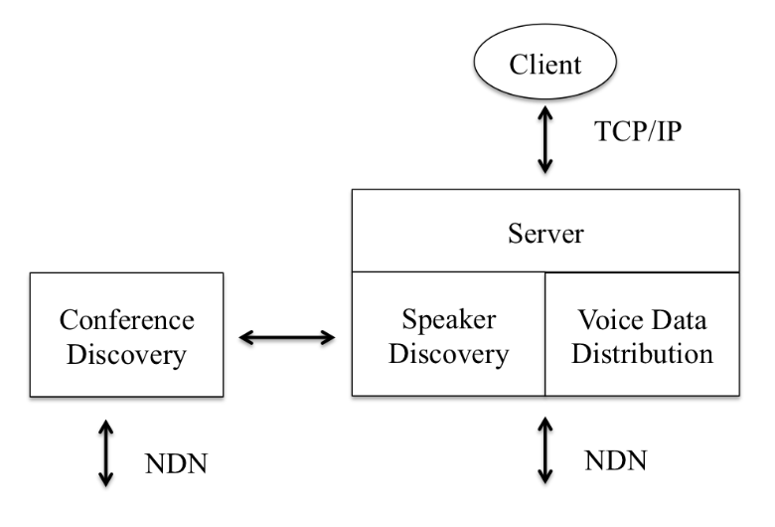
ACT Design
Conference Discovery:
Collect the latest information about all existing conferences.
Speaker Discovery:
Find the speakers in a conference.
Voice Data Distribution:
The information about the Voice data

Slide 7
Namespace
Broadcast namespace
For conference discovery, speakers discovery
User location based namespace
For voice data delivery

Slide 8
Conference Discovery
The name for conference data within NDN
( /ndn/broadcast/conference/conference-list)
/ndn The scope of network
/broadcast Broadcast name space
/conference Application type
/conference-list The data that the participant is interested in

Slide 9
Conference Announcement
SDP (Session Description Protocol)
Estimated starting time
Media type supported
Etc.
Appending conference name to the prefix “conference-list”

Slide 11
Conference Enumeration
Discovery module
Interest
Broadcast
conference-list
A : icn2011
Discovery module
Interest
Broadcast
conference-list
(Exclusion Filter)
A: icn2011
Any other node
Ex: (D: icn20XX)

Slide 12
Conference List Maintenance
refresh time
Discovery module
Known conference
remove time
When T(refresh) time out
Discovery module
Interest
Broadcast
conference-list
(Exclusion Filter)
A: icn2011
(New) A : icn2011
T(remove) = T(refresh) + maximum delay to retrieve data
When T(remove) time out, the conference should be removed from the conference list

Slide 13
Speaker Discovery
The mechanism of speaker discovery is similar to conferences discovery
(/ndn/broadcast/conference/[conference-name]/speak-list)
ACT scale well
only track a list of active speakers

Slide 14
Voice Data Distribution
Each speaker uses topology-dependent name prefix for its voice data
(/ucla.edu/cs/zhenkai/[device-id]/[codec-name]/[seg-num])
device-id 32-bit random string
seg-num sequentially named and stored in a circular buffer

Slide 15
Summary
The intermediate routers can reduce most repeated packets.
If server crash or disconnect, the traditional method couldn’t continue the conference but NDN could.

Slide 16
Reference
Zhenkai Zhu et al., ACT: Audio Conference Tool Over Named Data Networking , Proceedings of the ACM SIGCOMM workshop on Information-centric networking (ICN'11), pp. 68-73, August 19, 2011.
Session Description Protocol

