Slide 1
ChronoChat – Serverless Multi-User Chat Based On ChronoSync Over NDN
Zhenkai Zhu and Alexander Afanasyev
University of California, Los Angeles
IEEE 2013
Presenter and modifier : Jia-Wei Lin

Slide 2
Outline
Introduction
Traditional chat application
Named Data Networking(NDN) architecture
ChronoSync Design
Handling of Complex Scenarios
Conclusion

Slide 3
Introduction
Synchronization in applications play an important role in our daily life.
File sharing
Group text messaging
Collaborative editing
….Etc.
Quite a few popular applications have their way to synchronize dataset:
Dropbox and Google Docs : Centralization
BitTorrent Sync service : Peer-to-Peer
ChronoChat : Serverless multi-user chat based on ChronoSync over NDN

Slide 4
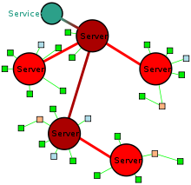
Traditional Chat application - IRC
IRC(Internet Relay Chat service) – based on TCP/IP

Slide 5
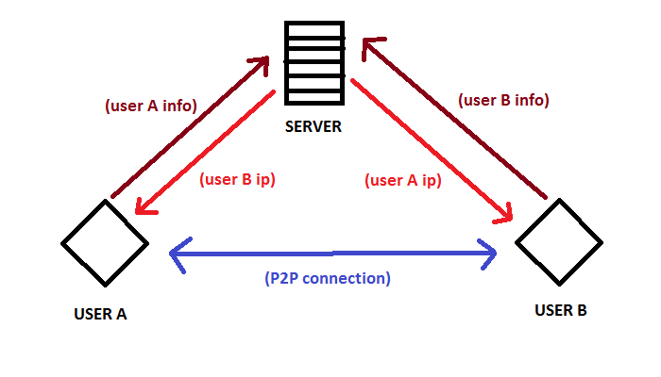
Traditional Chat application – P2P chat

Slide 6
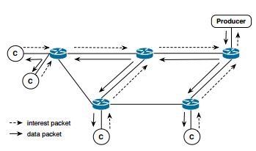
NDN architecture
Two basic communication units : interest packet and data packet.
All communication in NDN is receiver-driven.
Pending Interest Table (PIT) : recording the interface which sent interest packet.
PIT mechanism makes multicast be naturally supported in NDN.

Slide 7
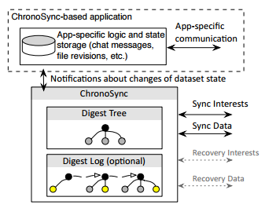
ChronoSync overview
Two interdependent components of ChronoSync-based application :
The application logic module : Respond to the change of the dataset state.
ChronoSync module : Synchronize the state of the dataset.
Notes:
State of the dataset

Slide 8
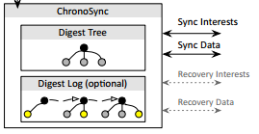
ChronoSync overview (cont.)
ChronoSync encodes the state of dataset into a crypto form( e.g. SHA256 ), this form we call the state digest, or digest in short.
In ChronoChat , ChronoSync module maintains the current user’s messages in digest tree , as well as history of the dataset state changes in digest log.
Notes:
Digest tree

Slide 9
Naming rules of ChronoSync
Unique prefix
The application name and the chatroom name.
(3) Sequence number
Prefix in broadcast namespace for a given broadcast domain.
The application name and the chatroom name.
The latest state digest of the interest sender.
Notes:
(Chat data name)The initial message sequence number is zero and whenever a participant generates a new message, be it a text message, a user status, or a heartbeat, the sequence number is increased by one.

Slide 10
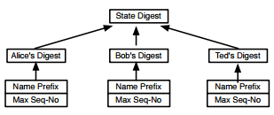
Maintaining dataset state
Each child node of the tree root holds a cryptographic digest calculated by applying hash function over a user’s producer status.
Whenever a ChronoChat user sends or learns messages , the corresponding branch of the digest tree is updated and the state digest is re-calculated.
Notes:
For the sake of simplicity in writing, we refer to the latest application data name of a producer as its producer status.

Slide 11
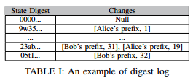
Maintaining dataset state (cont.)
Each party keeps a digest log along with the digest tree.
It is helpful to resolve the difference in participants from a temporary disconnection.
This log is a list of key-value pairs arranged in chronological order , where the key is the state digest and the value field contains the producer status.

Slide 12
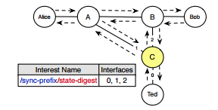
Propagation dataset changes
Every party keeps an outstanding sync interest with the current state digest.
For each chatroom, at most one sync interest is transmitted over a link in one direction.
PIT of router C

Slide 13
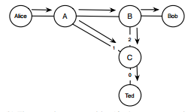
Propagation dataset changes (cont.)
When Alice sends a text to the chatroom, ChronoSync module on her machine immediately notice that its state digest is newer and hence proceeds to satisfy the sync interest with sync data.
Whoever receives the sync data updates the digest tree and sends out a new sync interest with the updated state digest.

Slide 14
2.
791 is the latest … Recalculate state digest
Steady state again!
4.
New message!
Update my digest tree…
1.
Have lunch?
5. Send Interest
/ndn/broadcast/chronos/lunch-talk/a123edf452d….
Alice
A
B
Bob
/ndn/broadcast/chronos/lunch-talk/791
New state digest :
a123edf452d….
3. Reply interest with data
State Digest
State Digest
State Digest
State Digest
Alice’s Digest
C
Alice’s Digest
Bob’s Digest
Ted’s Digest
Alice’s Digest
Alice’s Digest
Bob’s Digest
Ted’s Digest
/wonderland/alice
/rainbow/bob
/ncnu/ted
790
280
3310
790 -> 791
/wonderland/alice
/rainbow/bob
/ncnu/ted
790 -> 791
4.
Bob and Ted’s digest tree
790
280
3310
5. Send Interest
New message!
Update my digest tree…
Alice’s digest tree
/ndn/broadcast/chronos/lunch-talk/a123edf452d….
Ted

Slide 15
Propagation delay
I can’t recognize this state digest…
wait Tw
Sync data
Arrive in timer Tw
Alice
A
B
Bob
I send a message : Hello World!
I receive the data, so I can recognize the sync interest now!
C
Sync Interest
I receive the data, and I send the Interest with the new state digest.
Ted
Notes:
Tw : propagation delay.
To cope with this problem, ChronoSync employs a randomized wait timer Tw, with value being set approximately on the order of the propagation delay.
In the example, Bob’s state digest would become the same as the new digest after Alice’s reply reaches him, before Tw expires.

Slide 16
Participant Join – Only one participant
3.
1.
Interest expired… so I’m the only one participant.
I join this chatroom.
Initialize digest tree and send interest…
Alice
A
B
Bob
/ndn/broadcast/chronos/lunch-talk/[Empty]
State Digest
2. Send sync interest
State Digest
/ndn/broadcast/chronos/lunch-talk/0
Alice’s Digest
Alice’s Digest
4. Send sync interest with sequence number 0
C
/wonderland/alice
Empty
Empty -> 0
Alice’s digest tree
Ted
Chatroom name : lunch-talk
Notes:
Note that the root digest of an empty tree at startup is always “00”

Slide 17
Participant Join – Multi-users in chatroom
5.
New participant… reply all producer statuses.
1.
I received the data.
Build my digest tree…
I join this chatroom.
Initialize digest tree and send interest…
/ndn/broadcast/chronos/lunch-talk/a123d4f2…
4. Sync data
Alice
A
B
Bob
/ndn/broadcast/chronos/lunch-talk/[Empty]
State Digest
2. Send sync interest
State Digest
6. Send sync interest with new state digest
Alice’s Digest
Bob’s Digest
Ted’s Digest
Alice’s Digest
C
The latest state digest : a123d4f2…
New participant… reply all producer statuses.
/wonderland/alice
/rainbow/bob
/ncnu/ted
Empty -> 0
Empty
280
3310
/ndn/broadcast/chronos/lunch-talk/a123d4f2…
4. Sync data
Alice’s digest tree
Ted

Slide 18
Participant Leaves
Participants should inform others in the room before actually leaving.
Participants who intends to leave should reply to the sync interest with the data name for an “unavailable” message. On receiving the “unavailable” message, others remove the participant from their rosters.
Sometimes a participant may not have the chance to leave with grace. In these cases, other participants would notice this event when they miss a certain number of heartbeats from the participant who had left.
Heartbeats messages : Periodically sent by participants if they have no chat messages to send.
Notes:
Status messages, including “available,” “unavailable,” and others are treated in the same manner as any normal text chat message.

Slide 19
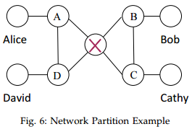
Handling network partitions
When the wait timer Tw expires and the unknown digest is still unrecognizable, a participant proceeds to send a recovery interest.
It is similar to a normal sync interest, but has a “recovery” component before the digest and includes the unknown state digest.
Those who recognize the digest (e.g. having it in their digest log) reply the recovery interest with the most recent producer status of all users.

Slide 20
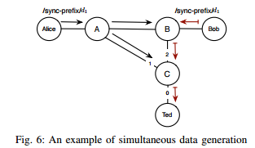
Handling simultaneous data generations
When the wait timer Tw times out, Ted proceed to send a sync interest with the previous state digest again, but this time with an exclude filter that contains the hash of Bob’s sync data.
Routers understand that Bob’s sync data cannot be used as the reply to the interest.
6. Alice’s data with Bob’s sync data
3. Alice’s data
2. interest
1.
I can’t recognize the state digest… wait Tw
5. Send interest again with exclude filter
4. Tw expire
Notes:
我猜Sync data裡面不只有聊天訊息，還藏有計算過後的State digest, 所以End host 收到 Sync data時會先看這個State digest 是不是跟自已的一樣(steady state)

Slide 21
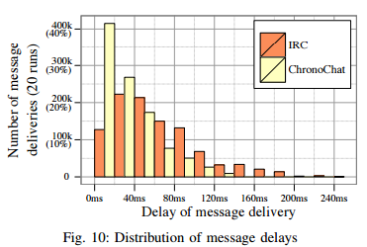
Evaluation : IRC vs ChronoChat
IRC : Internet Relay Chat service, based on TCP/IP.
(1) Performance under normal network condition :
Notes:
ChronoChat 整體的 Delay 較小

Slide 22
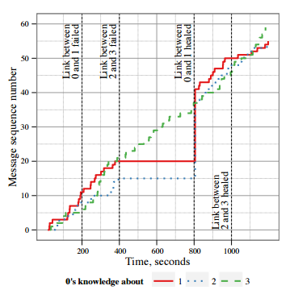
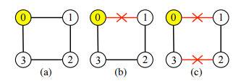
Evaluation
(b)
(c)
(2) Synchronization resiliency to network failures:

Slide 23
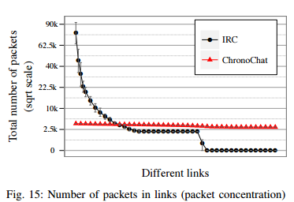
Evaluation : IRC vs ChronoChat
(3) Network utilization pattern
ChronoChat : More or less equally utilizes all of the available network links between participants.
IRC : A few links close to the server have high packet concentrations.

Slide 24
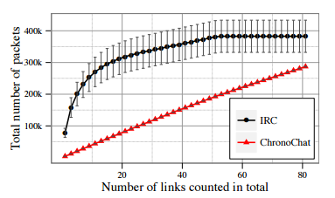
Evaluation : IRC vs ChronoChat
(4) Overall overhead

Slide 25
Conclusion
ChronoSync is a decentralized dataset synchronization protocol for distributed application running in NDN, such as ChronoChat – a serverless multi-user chat application.
This protocol removes both single point of failure and traffic concentration problems common associate with centralized implementations.
ChronoSync is highly robust in faces of network partitions.

Slide 26
Reference
Chronos: Serverless Multi-User Chat Over NDN , Zhenkai Zhu , Chaoyi Bian , Alexander Afanasyev∗, Van Jacobson , and Lixia Zhang, Technical Report NDN-0008, 2012 , obsolete version
Let’s ChronoSync: Decentralized Dataset State Synchronization in Named Data Networking , Zhenkai Zhu and Alexander Afanasyev University of California, Los Angeles , IEEE 2013
ChronoChat Web Application : http://named-data.net/apps/live/chat/
Notes:
In ChronoChat, a broadcast prefix for the chat room “lunch-talk” would be “/ndn/broadcast/ChronoChat-0.3/lunch-talk”.

