Slide 1
Performance Measurement, Evaluation and Analysis of Push-to-Talk in 3G Networks
Communications, 2007. ICC '07. IEEE International Conference on
W.-P. Chen , S. Licking , T. Ohno , S. Okuyama , T. Hamada

Slide 2
Outline
What is push to talk(PTT)?
What is push to talk over cellular(PoC)?
Evaluation of Their PoC on the US 3G PS(Packet Switch) Networks
Conclusion and Future

Slide 3
What is Push To Talk(PTT)?
Half duplex
Instantly communicate
Commonly employed in wireless cellular phone services that uses a button to switch a device from voice transmission mode to voice reception mode

Slide 4
What is Push To Talk over Cellular(PoC)?
Near real-time voice communications to users in the same group
Enable subscribers to use their phones as walkie-talkies with unlimited rang
Packet-switched version of PTT
The main components of the PoC system : PoC Clients, PoC Server, Group and List Management Server (GLMS), Presence Server, and IMS
Notes:
The Group and List Management Server manages contact lists, groups and access lists while the Presence Server manages the presence information of the PoC Clients.
The dissemination of control signaling between the components in the PoC system is mainly supported by IMS, a subsystem in 3G core networks.

Slide 5
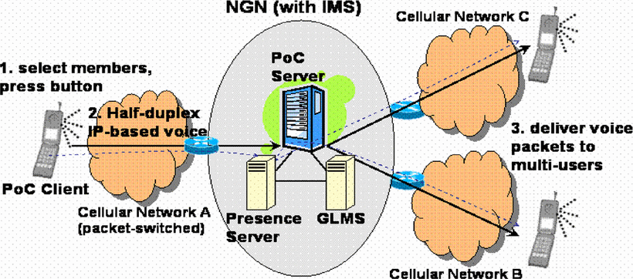
PoC Operations
Notes:
(1)The caller selects one or many people from his/her contact list and presses the talk button.
(2)The PoC Server establishes sessions to all participants and notifies the caller to start to talk.
(3)The voice data are sent in packets and relayed by the PoC Server to all the members.

Slide 6
Evaluation of Their PoC on the US 3G PS Networks
Three major wireless broadband service providers are considered in the evaluation.
Two types of codecs are used in our PoC system: AMR half rate (4.75 kbps) and GSM6.10 (13.2 kbps).
The measurements are taken in the California Bay Area.

Slide 7
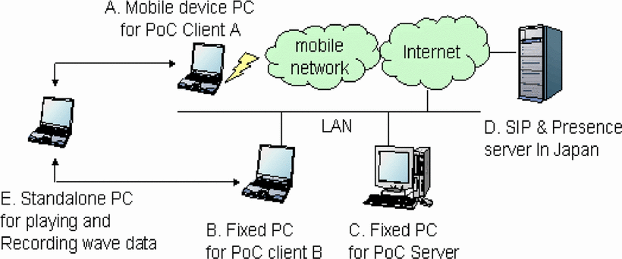
Environment for PoC Evaluation

Slide 8
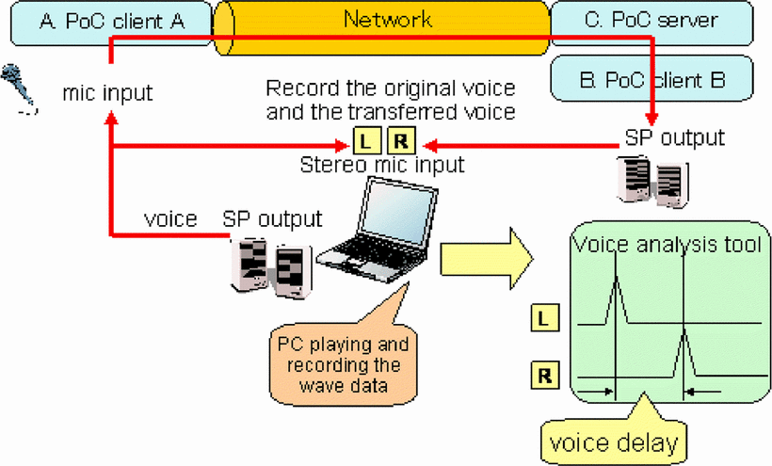

Slide 9
PoC Control Latency
The delays are encountered when performing actions such as starting a PoC session and floor arbitration.
PoC Start to Okay
PoC Start to Join
Floor Request
Floor Release

Slide 10
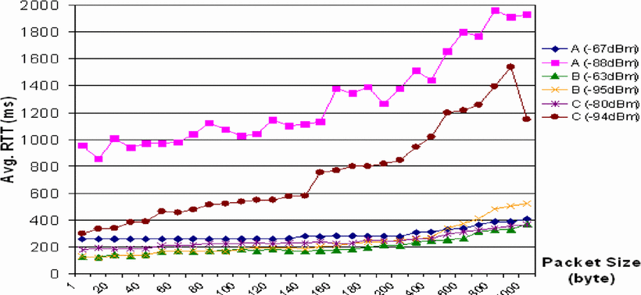
The round-trip time(RTT) between the MD(Mobile Device) and the server
Notes:
Under good signal reception, the RTT is below 400ms even as the packet size increases up to 1000 bytes.
However, in weak signal settings, Network A and C's RTTs increase dramatically while Network B's RTTs only increase slightly.

Slide 11
Control latency results (unit: ms)
When the MD(Mobile Device) is in dormant mode, there exists an extra delay in control latency of “PoC Start to Okay” and “PoC Start to Join” (The latencies in Network A under dormant mode are 3.3 and 3.7 seconds, respectively)

Slide 12
PoC Voice Latency
downlink voice delay is shorter than uplink delay
longer frames also undergo longer latency
Voice latency is constituted by two components (1)Data frame time can be seen as the base of voice latency. (2)Packet propagation time is determined by both packet payload length and link bandwidth.

Slide 13
Data rate of TCP connections
A file, with a size of three megabytes is sent over a TCP connection either by the MD or server to measure the effective data rate of uplink and downlink.
Downlink throughput is much higher than uplink throughput in all three networks.

Slide 14
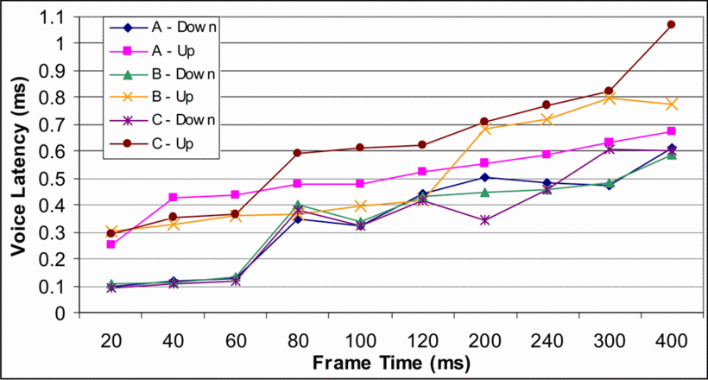
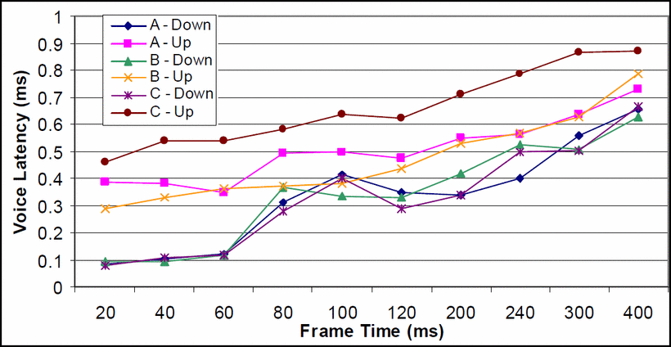
Voice latency using the AMR half rate (4.75kbps) codec
Voice latency using the GSM6.10 (13.2kbps) codec
no apparent difference in the results of AMR and GSM6.10 codec

Slide 15
PoC Voice Quality
The downlink tests sound excellent due to the additional bandwidth
The sound quality of higher frame time recordings are better despite the noticeably larger impact of packet losses made on these tests.
Once a long frame is lost, it is more difficult to recover cleanly from the loss.
The trade-off between sound quality and frame loss is a key factor to determine the frame time.

Slide 16
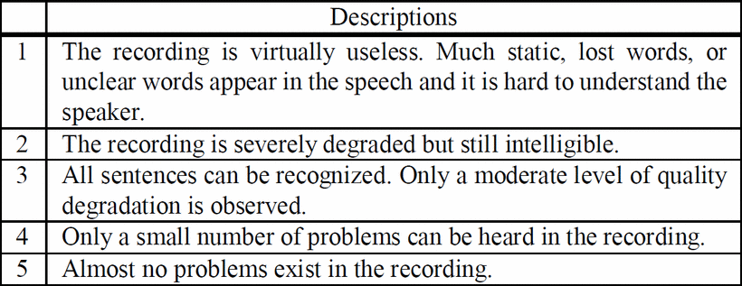
Descriptions of voice quality in each score
Notes:
The voice quality test is a subjective evaluation of the quality of the sound traversed through the PoC system.

Slide 17
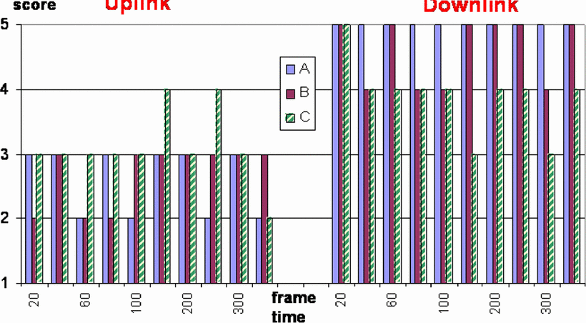
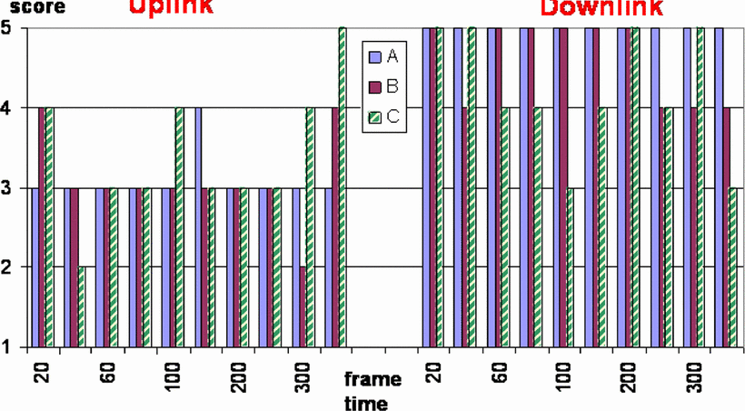
Results of voice quality using the AMR codec
Results of voice quality using the GSM6.10 codec

Slide 18
Conclusion and Future
Their PoC solution can be easily deployed in current 3G systems to provide high quality voice and value-added services to end users.
One extension of this study is to investigate ubiquitous VoIP system/PTT over Cellular and Wireless networks. Moreover, currently the 3G network has no Quality of Service (QoS) capability.
Even though the PoC (half duplex media transmission) application is feasible on the 3G network, other real-time stream services such as IPTV, VoIP and video conferencing require the support of QoS from the network.

