Slide 1
Analyzing and Improving Session Setup Latency of Push-to-Talk over Cellular
2012 8th International Conference on Wireless Communications, Networking and Mobile Computing (WiCOM
Dawei Ma; Wei Huang; Wei Li; Sheng Chen; Binde Luo

Slide 2
Session setup latency(delay)
Users of SIP-based PoC usually should wait a period of time between initiating a session to setting up one end-to-end connection due to the interchange of signaling messages and much longer transmission delay of wireless network.
It is approximately a period of time over 6–7 seconds, or even up to more than 10 seconds.[1]

Slide 3
Session setup latency(delay)
Three main sections in session setup latency of PoC:
  Setting up the data channels over the radio link
  The transfer of SIP messages over the established radio link
  Transport in core of the mobile communication network and the processing of the message
Session setup latency may be reduced if we transmit the compressed
SIP signaling messages instead of the standard SIP signaling messages.[2]
Notes:
Setting up the data channels over the radio link (20%~30%)
The transfer of SIP messages over the established radio link (40%)
Transport in core of the mobile communication network and the processing of the message (30%~40%)

Slide 4
Session setup latency(delay)
Tr(1): the timer of first transfer, usually is a approximate value of Round Trip Time(RTT) which is 500ms in default [3]
Tr(i): the timer of ith
→ Tr(i)=2^{i−1} ×Tr(1)

Slide 5
Session setup latency(delay)
Usually the transfer time of SIP messages includes the retransfer time because of the error occurring. We assume following conditions:
  1. The error of signaling message transferring only results in re-transferring instead of replying.
  2. It is linear correlation between the frame error ratio and message error ratio. There message consists of frames.
  3. The wireless condition is based on the TD-SCDMA mobile communication network.
Then the average transfer time of one SIP message is Ttransim.
Notes:
TD-SCDMA: Time Division - Synchronous Code Division Multiple Access

Slide 6

Session setup latency(delay)
Ttransim = T + $\sum_{i=1}^{m}{P^{N}}$×Tr(i)∗
  T = N$(\frac{Mmessage}{Rlink}+\frac{RTT}{2}$)
  P = $\frac{Mmessage}{Mframe}$ X FER
  Tr(i)∗ = T + Tr(i)
The smaller the Mmessage is, the shorter the Ttransim is.
We can reduce the transfer delay if we can cut down the length of SIP messages.
Notes:
Mmessage denotes the length of a SIP message.
N denotes the quantity of messages needed during one call setting up procedure.
Rlink denotes transfer rate of wireless link, Rlink=9.6kbits/s
FER is the frame error ratio.
Mframe is the length of a frame.

Slide 7
A New Method of SIP Compression-IDCM
SIP signaling is consists of 44 characters and can be classified as two part, one part is instructions (“INVITE”, “BYE”, etc.) and another part is user's data.
An improved dictionary-based compression method (IDCM) of SIP compression to reduce the setup latency that using a new dictionary table with expanded elements for more possible transferred messages.

Slide 8
A New Method of SIP Compression-IDCM
Make a dictionary table to put in all the characters of SIP messages. The dictionary table includes 44 characters of SIP signaling. Meanwhile some frequently used short terms and expressions are also included in this dictionary table.
Every data put in the table is called an element. One element is expressed by a 10-bit number. So we set the size of the dictionary table to 1024(2¹⁰=1024).

Slide 9
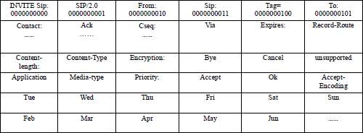
A New Method of SIP Compression-IDCM

Slide 10
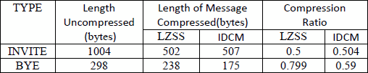
Analysis (compare IDCM with LZSS)
Compare the compression ratio of the proposed IDCM with that of LZSS using a typical segment of SIP signaling “INVITE” & “BYE”.

Slide 11
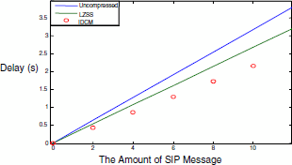
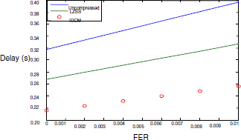
Transfer Delay
Session setup latency vs. the amount of SIP messages
Session setup latency vs. FER

Slide 12
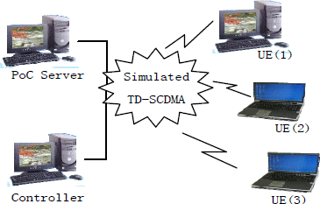
Performance estimation on the prototype of POC system based on TD-SCDMA network
Notes:
User Terminal (UE)

Slide 13
Performance estimation on the prototype of POC system based on TD-SCDMA network
Tested the session setup latency for 100 times:

Slide 14
Conclusion
Session setup latency of the SIP-based PoC system is the primary block to extend PoC application. It is obviously necessary to reduce the transfer time in bandwidth-limited wireless condition because of the transfer time occupying about 40% of the whole setup latency.
The smaller the size of the messages transferred is, the shorter the transfer time needs.
Compared the proposed IDCM with traditional algorithm such as LZSS and observed much better performance of IDCM.

Slide 15
Reference
[1]http://ieeexplore.ieee.org/document/5715543/
[2]http://ieeexplore.ieee.org/document/1424902/
[3]http://journal.cqupt.edu.cn/jcuptnse/ch/reader/create_pdf.aspx?file_no=20070623&year_id=2007&quarter_id=6&falg=1

