Slide 1
Home Video Surveillance over NDN
Presenter: Chelsea

Slide 2
Outline
Motivation
System Architecture
Reference

Slide 3
Motivation
「住宅竊盜」為台灣即時犯罪類型前三大之一

Slide 4
System Architecture
IP/NDN Camera
Lock
Open homing-lock system
Alarm
Detection
Detect someone is climbing over the wall.
Mobile

Slide 5
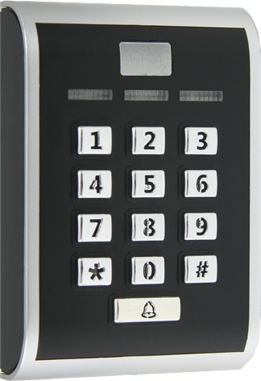
Homing-lock system based on NDN
NDN Router
Broadcast

Slide 6
Questions and Comment

