Slide 1
Pre-recorded Streaming using NDN
Nicole

Slide 2
Pre-recorded Software on Router
Router可以針對使用者比較常interest的data 進行預先interest的行為,這樣使用者之後只要從router就能得到data

Slide 3
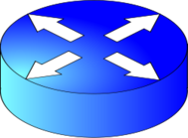
Server for Youtube
Server for Parc
Server for Voicetube

Slide 4
Reference
Random-access Live and Pre-recorded Streaming using NDN
Named Data Networking: Motivation & Details

