Slide 1
Domain name service for Named Data Networking
In proceedings of the 26th International Conference on Computer Communications and Networks (ICCCN), July 2017
Alexander Afanasyev, Xiaoke Jiang, Yingdi Yu, Jiewen Tan, Yumin Xia, Allison Mankin, and Lixia Zhang

Slide 2
Outline
Background
Domain Name System (DNS)
NDN DNS (NDNS)
Conclusion

Slide 3
Background
DNS
The main purpose of DNS is to resolve human-readable hostname into IP address.
NDNS
NDNS could support the consumer to get the forwarding hint.
Forwarding hint – If the consumer send an interest which is unreachable, the forwarding hint could direct the interest to the prefix which could reach the producer.

Slide 4
DNS
.
edu
ucla
com
google
root
Top-Level Domain
Second-Level Domain
gov
usa
www
www
www
Sub Domain

Slide 5
(Iterative query)
1. Where is www.google.com
2. Where is www.google.com
Client
Local DNS
.
3. I don’t know, but here is the name server of “com”
(Recursive query)
4. Where is www.google.com
Cached
No Record
com
5. I don’t know, but here is the name server of “google”
2. (8)The IP address is 172.217.27.132
6. Where is www.google.com
google
7. I know, the IP address is 172.217.27.132

Slide 6
DNS Security Extensions (DNSSEC)
Why do we need DNSSEC? If you query for “www.google.com”, the correct IP address should be 172.217.27.132, but it return the other one which may steal some personal information.
DNSSEC purpose:
Data integrity
Origin authentication of DNS data
Authenticated denial of existence

Slide 7
Digital Signature
Signing
MD5, SHA
RSA – Private Key
Data
Hash Value
Digitally Signed Data
Verification
MD5, SHA
Check
Data
Hash Value 1
RSA – Public Key
Digtally Signed Data
Hash Value 2

Slide 8
DNSKEY (KSK)
DNSKEY (ZSK)
RRSIG_{ZSK}
RRSIG_{RRset}
DS
Key Signing Keys (KSK)
Zone Signing Keys (ZSK)
Resource Record Sigature (RRSIG)
Delegation Signer (DS)
com
DNSKEY (KSK)
DNSKEY (ZSK)
RRSIG_{ZSK}
RRSIG_{RRset}
RRset
google.com
MD5, SHA
MD5, SHA
MD5, SHA
Check
Check
Check
KSK
ZSK
Hash Value 1
RRset
Hash Value 1
Hash Value 1
KSK – Public Key
ZSK – Public Key
DS
RRSIG_{ZSK}
Hash Value 2
RRSIG_{RRset}
Hash Value 2
Hash Value 2

Slide 9
NDNS
Recursive query – If the data is cached, the consumer could use the prefix “NDNS-R” to present a recursive query.
“/NDNS-R/net/ndnsim/www/TXT” (The closest NDNS)
“/com/google/NDNS-R/net/ndnsim/www/TXT” (The NDNS of google)
Iterative query – If the data is not cached, the iterative query would be looked like “/NDNS/ zone_name /NS”.

Slide 10
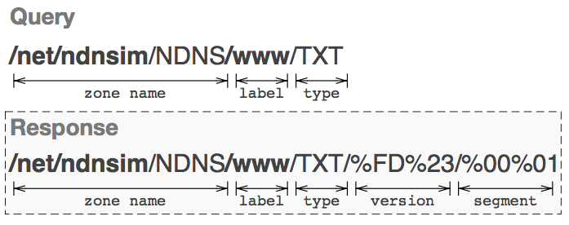
Label
It could be represent as services (ex: Web Service) or applications .
Type
TXT Free-formed text record
NS Forwarding hints
CERT NDNS public key certificates
APPCERT Applications certificate

Slide 11
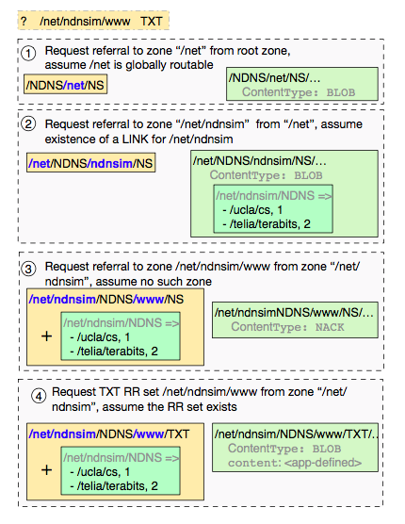
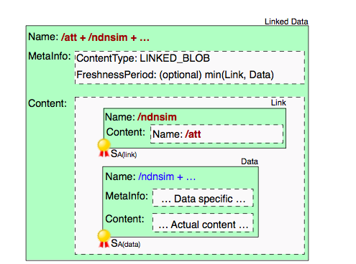
/ucla/cs + /net/ndnsim …
/net/ndnsim
/ucla/cs
/net/ndnsim + …

Slide 12
NDNS Security

Slide 13
Conclusion
NDNS can make that the producers who are not in the global network could be reachable.
NDNS is a example that even we port the similar mechanism from IP to NDN, it’s use could be different from traditional method.

