Slide 1
Data Naming in Vehicle-to-Vehicle Communications
Computer Communications Workshops (INFOCOM WKSHPS), 2012 IEEE Conference
L. Wang, R. Wakikawa, R. Kuntz, R. Vuyyuru and Lixia Zhang

Slide 2
Introduction
Today, many vehicles are connected to the network (Intelligent Transportation Systems, ITS) and can run a variety of applications on the head unit system, in addition to the usual navigation software.
However, vehicular networking over IP has a fundamental limitation: global IP address allocations.
And, high frequency of connectivity changes demands that routes be re-calculated and sessions be re-established.

Slide 3
Motivation
Native feature of NDN:
  Data name: no allocation of addresses
  Multipath routing: no setup of data delivery paths
  Interest/Data packet: no session establishment
Different vehicular applications may desire to sort data into different categories, or with different granularities.
Therefore, the data name need be well defined for all of the vehicles and express exactly what kinds of data the vehicles may desire.

Slide 4
Vehicle-to-Vehicle (V2V) Communication Technology
Dedicated Short Range Communications (DSRC)
  IEEE 802.11p, physical layer
Wireless Access in Vehicular Environments (WAVE)
  IEEE 1609, network layer
Licensed ITS band: 5.9 GHz (5.85-5.925 GHz)
Transmission Ranges: 100 to 500 meters
Numbers of reaching other neighbor vehicles within one DSRC hop:
  10 to a few hundreds
Notes:
transmission ranges: 100 to 500 meters depending on the radio frequency (5.85-5.925)

Slide 5
System Operation
Premise --
Sufficient memory space and transmission power
Broadcast between vehicles
Roles --
  Publisher -- produces data and stores it in its cache
  Data Mule -- collects data from other vehicles and itself
  Consumer -- sends Interest packets
Every vehicle is the publisher, the data mule and the consumer.
Notes:
NDN router would accept a data packet only if it has a corresponding entry in its PIT table. However in V2V communication, given the broadcast nature of DSRC/WAVE and WiFi channels, a vehicle can often hear data packets in responses to other vehicles’ requests. In order to serve as an more effective data mule, one should take the opportunity to cache all received data packets even when they are requested by others, rather than ignoring them.

Slide 6
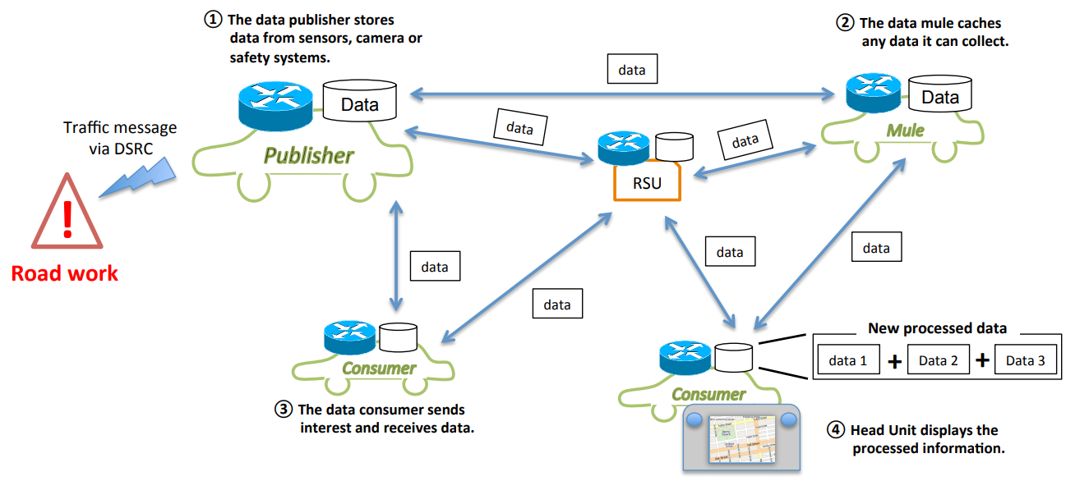
Topology
RSU : Road Side Unit
DSRC : Dedicated Short Range Communications
Data Mule
data 1
data 2
data 3
Notes:
Publisher -- produces data and stores it in its cache
broadcast the data
Data Mule -- collects data from other vehicles and itself
Sends Interest packet periodically
Disseminates the traffic information to vehicles in many different locations
Keeps the information available
Consumer -- sends Interest packets
Retrieves data from publishers and mules
Collects multiple pieces of data from different cars
Every vehicle is Publisher, Data Mule and Consumer.
New processed data :計算data,例如算出所有得到車速的平均值

Slide 7
Data Name for Traffic Application
Structure: /application/geolocation/timestamp/data type/nonce
Example:
  /traffic/Highway 101/north/{400,410}/{1323201600,1323205200}
/speed/19375887
  /traffic/Highway 101
Explain:
/application: application ID
/geolocation: road ID (+ link ID) /direction/section number
/timestamp: UNIX timestamp format
/nonce: random number

Slide 8
Data Manipulation - Consumer
Duplication detection and elimination
  Requester include nonce of data
Data accuracy
  Avoid using the same input data for further processsing

Slide 9
Data Manipulation - Publisher, Data Mule
Data Pool
List name: Only list the name of available data pieces
  The consumer can issue subsequent Interests with specific names.
Choose data: Randomly choose some pieces of data
  The more the publishers and the data mules reply, the more complete the information of the consumer is.
Name: 111
117 Km/h
Name: 222
84 Km/h
Name: 333
97 Km/h
Name: 444
183 Km/h
Name: 555
89 Km/h
Name: 666
103 Km/h
List name
Random choose
111
222
333
444
555
666
Name: 111
117 Km/h
Name: 666
103 Km/h

Slide 10
Conclusion
This design allows vehicles to collect and disseminate traffic information among themselves using data names that are predefined.
With this design, the driving route of a vehicle may be known by the other vehicles. In order to protect the privacy of a vehicle, the data authenticity is an important issue that need be discussed.

