Slide 1
Improved Content Addressability Through Relational Data Modeling and In-Network Processing Elements
Presenter: Ken

Slide 2
Outline
What are the problems?
Named Function Networking(NFN)
Relational Named Data
Query Language
General-Purpose Processing
Meta-Data For Derived Relations
Discussion and Future Work
Conclusion
Jonathan’s First Idea

Slide 3
What are the problems?
Joe wants to publish a document about his NYmarathon in 2017.
Here is the prefixes he can choose.
/personal/joe/2017/events/…
/personal/joe/marathons/…
/organizer/NYmarathon/2017/ranking/1/…
/organizer/Nymarathon/2017/joe/…
But not all of them could be made visible on CCN name level. And there may be some implicit information which is relevant but can’t be part of the name surface.
(e.g. time-location track, length, average speed…)
Notes:
The CCN network layer organizes access of known documents but lacks of e ective index structures to discover all data chunks within a certain collection

Slide 4
Introduction
A single document could be a part of several data collections.
A Content-Centric Network is a database.
Data chunks are base elements.
Granting such rights for a document which could be available under multiple prefixes.
In CCN, content names are organized in a hierarchical namespace.
Content objects are essentially a unique and unchangeable binding of certain payload to a name.

Slide 5
Named Function Networking(NFN)
Named Function Networking augments CCN with an in-network content derivation machinery.
Names are computation expressions which include data and function names. /fct/provider/wordcount(/a/nice/poem.txt) /fct/provider/named function(content object)

Slide 6
Named Function Networking(NFN) – Cont.
A function call can also be the argument to another function call (function chaining) /fct/prvdr/wordcount(/first/verse(/a/nice/poem.txt))

Slide 7
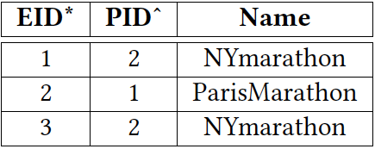
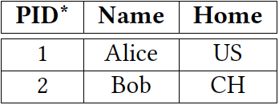
Relational Named Data
Named Relations
A named relation is a set of special tuples which are carried by a content object.
/repo/people
/repo/events

Slide 8
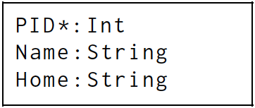
Relational Named Data – Cont.
Relation Schemata
The comprehensive description of a named relation is published as a separate document.
/ietf/relations/ people
/ietf/relations/events

Slide 9
Relational Named Data – Cont.
Relation Type Schemata(RTS)
Per publisher of named relations there exists a relation type schema.
RTS assigns a relation schema to each named relation.
/repo/rts

Slide 10
Query Language
Joining Relations(Table concatenate)
Joining two relations means to unite them into a single relation. /join(/repo/events as ‘event’, /repo/people as ‘ppl’)
Joined Named Relations

Slide 11
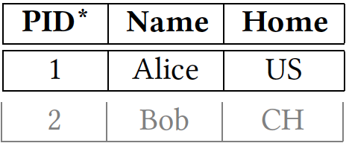
Query Language – Cont.
Restricting a Relation (Row select)
A restriction of a relation is a selection of certain tuples according to a given criterion. /restrict( /repo/people, Home == ‘US’ )
Restricted Named Relation

Slide 12
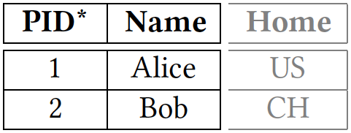
Query Language – Cont.
Projecting a Relation(Column select)
Projecting a relation means to take some attributes and erase all others. /project( /repo/people, [PID,Name] )
Projected Named Relation

Slide 13
Query Language – Cont.
Since join, restrict and project map relation(s) to one new relation, arbitrary function chaining is possible.
ppl.Home
CH
CH

Slide 14
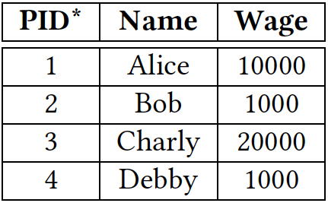
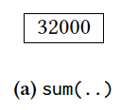
General-Purpose Processing
Sum
Accumulates all values in a certain column. /sum( /repo/employee, ‘Wage’ )
/repo/employee

Slide 15
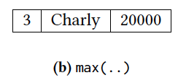
General-Purpose Processing – Cont.
Max
Extracts the tuple(s) with the highest value in a certain column. /max( /repo/employee, ‘Wage’ )
/repo/employee

Slide 16
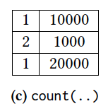
General-Purpose Processing – Cont.
Count
Identifies how many times the values in a certain column occur. /count( /repo/employee, ‘Wage’ )
/repo/employee

Slide 17
Meta-Data For Derived Relations
Primary and derived named relations must be described by a relation type schema.
The derived relations
The RTS of a join's output must union both input-RTS.
Input and output relation of restrict are described by the same RTS.
The RTS which describe input and output of project are similar.

Slide 18
Discussion and Future Work
CCN‘s working assumption - The exterior information is sufficient to orchestrate synchronization between publisher and consumer.
The question
A hierarchical namespace is not well suited to structure highly linked and multifaceted data.
The solution
Network entities which bridge the name surface with interior knowledge.
Content Objects
Considering meta-data
The primary content has no especially informative name, but consumers hold recipes to form à-la-carte names.
The recipes to query à-la-carte content is given by the query language and document type schemata.

Slide 19
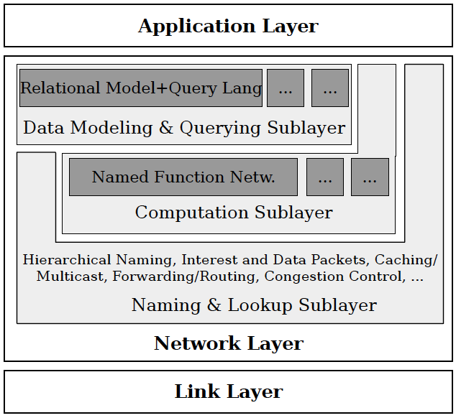
Discussion and Future Work – Cont.
Naming & lookup sublayer (common CCN)
comprises services
hierarchical content naming
pull-based content lookup
multicast/caching
forwarding/routing
congestion control
Computation sublayer
The encoding of functional computation expressions into hierarchical CCN names.
A computation expression (in computation sublayer) constitutes the name of the result (in naming & lookup sublayer)
The system implement in computation sublayer is NFN-Scala.
Data modeling & query sublayer
Data organiztion
Information query service to application layer

Slide 20
Discussion and Future Work – Cont.
Trust model
Issuer trusts the providers of all incorporated functions.
Issuer trusts the provider of all processed named relations.
Issuer trusts the computation node which immediately produces the final result.
Access control
Since the query format is built into the CCN namespace, it gain highly descriptive content names.
Schematized access control
Access for a content object is granted to a certain principal (e.g. a user or a group) if the content’s name is caught by a name-pattern matching rule in the principal’s capability schema.
Name Privacy
Highly descriptive names are beneficial for name- based/schematized access control but also rise name privacy concerns.
Notes:
A certain principal is allowed to access the personal record of an employee only if the birthday is removed (or technically: if the query includes a project function which excludes the attribute “birthday”).

Slide 21
Conclusion
An information-centric network which can manage structured, annotated and interlinked information is the right approach to build such a “global” integration point.
Although this paper exemplarily illustrated by means of the relational data model, it doesn’t provide if we use this model that we can get what kind the performance compare to origin.
Notes:
A “data modeling layer” on its own is not sufficient because also active, processing elements are required to support application-specific on-demand querying.

Slide 22
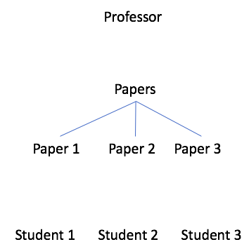
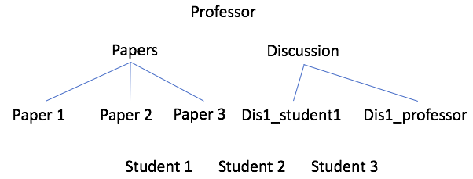
Jonathan’s First Idea
加入Student 1和Professor的會議紀錄後的架構
傳統NDN架構下Professor和Student的範例

Slide 23
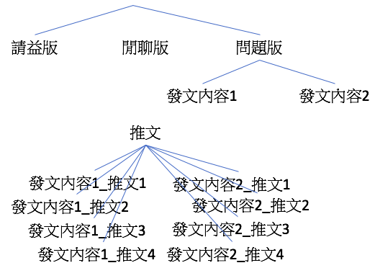
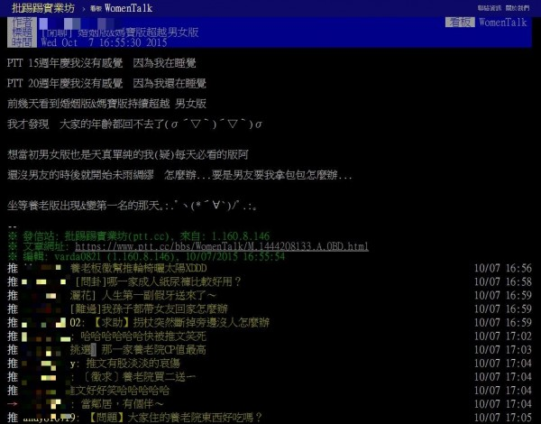
Jonathan’s First Idea – Cont.
傳統的PTT
假設PTT正常運作在NDN

Slide 24
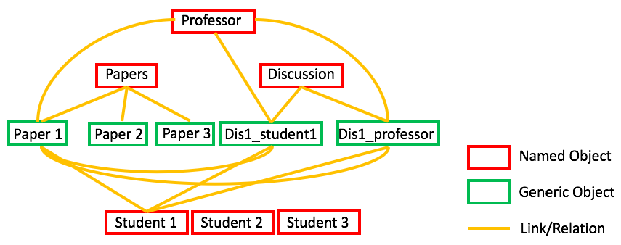
Jonathan’s First Idea – Cont.
將Professor和Student例子建立Object Relationship

Slide 25
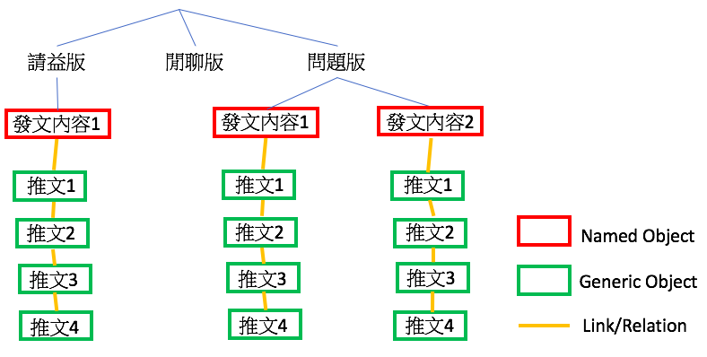
Jonathan’s First Idea – Cont.
將電子布告欄例子建立Object Relastionship

