Slide 1
Sharing mHealth Data via Named Data Networking
Haitao Zhang¹, Zhehao Wang¹, Christopher Scherb², Claudio Marxer² , Jeff Burke¹, Lixia Zhang¹
1. University of California, Los Angeles 2. University of Basel

Slide 2
Outline
Motivation
NDNFit Component and Architecture
Namespace Design
Trust Management
Data Transport Protocol
NDN Access Control
Conclusion

Slide 3
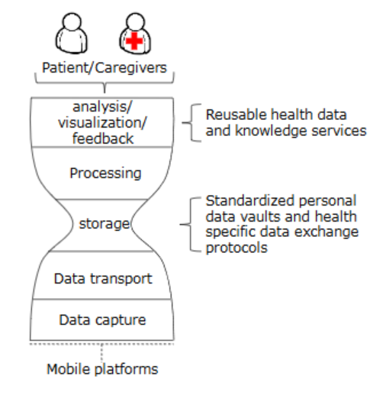

Motivation
What is Open mHealth?
    an ecosystem for health data sharing
What is NDNFit?
  A distributed mHealth application used NDN architecture instead of TCP/IP
Why use NDN for Open mHealth?
  NDN and Open mHealth share data exchange as the “thin waist”
Introduction Video : An intro to Open mHealth

Slide 4
NDNFit Components
Capture Apps
  Collect user’s health data
Data Storage Unit (DSU)
  Repository for user’s health data
Data Processing Unit (DPU)
  Produce derived data
Data Visualization Unit (DVU)
  Enable user to visualize and interact with their data

Slide 5
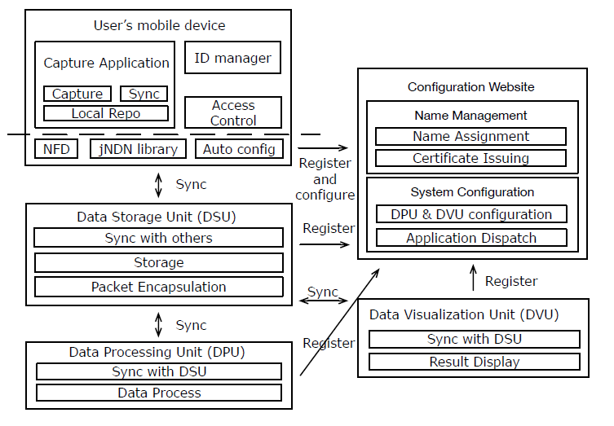
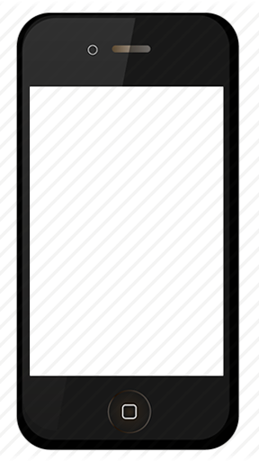
NDNFit Architecture
DSU
DVU
DPU

Slide 6
Namespace Design
Goals :
  Name the data from an application perspective
  Use only Interest-Data exchange
  Reflect the trust relationships between different system elements
  Enable name-based access control
Four children of user namespace :
Key
Devices
Data
Read

Slide 7
``
Prefix
/org/openmhealth
User and component identifiers
key
<user-id>
<service-id>(DPU, DVU)
<version>
``
devices
key
key
<device-id>
<version>
<version>
Health data source
key
<version>
``
read
Data
Data type
fitness
D-KEY
E-KEY
fitness
…
…
Physical_activity
D-KEY
E-KEY
Physical_activity
…
…
time_location
D-KEY
E-KEY
time_location
bout
…
…
``
…
D-KEY
E-KEY
<timestamp>
``
catalog
C-KEY
<start_timestamp_hour>
<start_timestamp_hour>
DATA OBJECT
<start_timestamp_hour>
<segment>(opt.)
<timestamp>
<end_timestamp_hour>
PUBLIC KEY
DATA OBJECT
DATA OBJECT
<end_timestamp_hour>
<end_timestamp_hour>
<version>
FOR
Raw data
& Catalogs
FOR
ENCRYPTED
PRIVATE KEY
SYM KEY
ENCRYPTED
<consumer-id>
<E-KEY name>
Access control

Slide 8
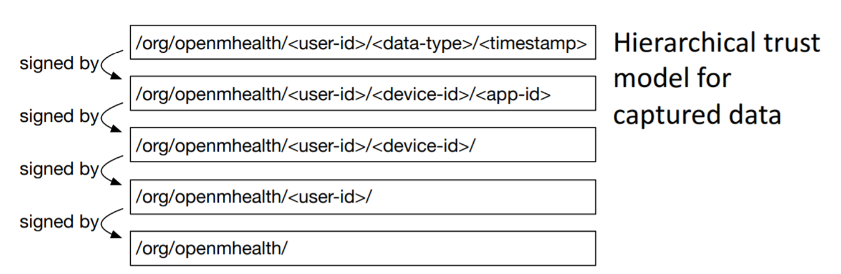
Trust Management

Slide 9
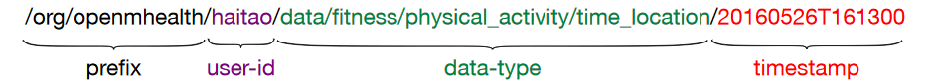
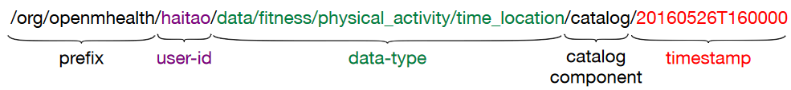
Data Transport Protocol
Time-location data packet name
  Fetched data on particular second
Catalog – manifest-style object produced at know intervals
  Fetched packetize data based on hourly basis

Slide 10
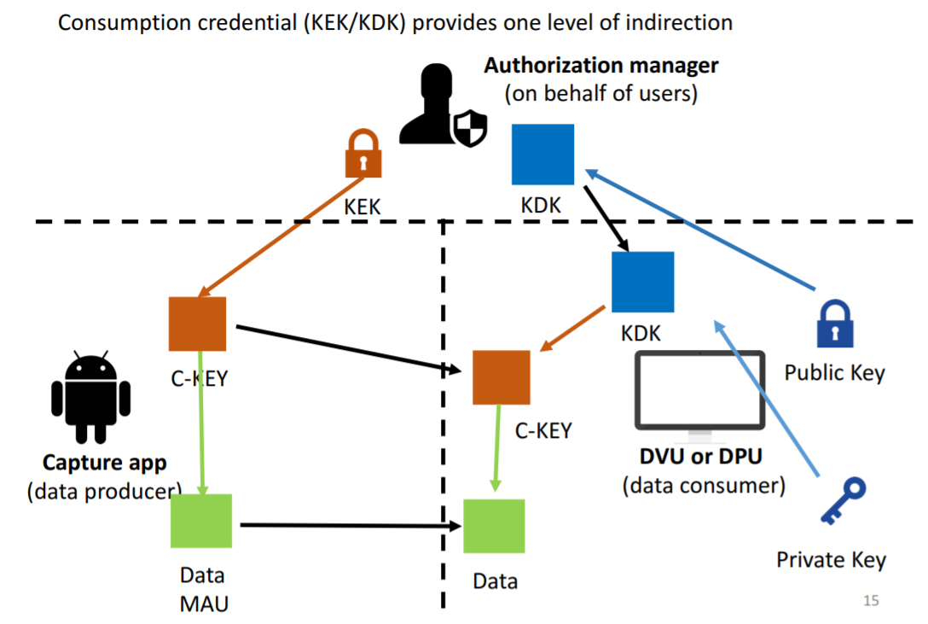
NDN Access Control
KEK – Key-encrypt Key
KDK – Key-decrypt Key
C-KEY – Content Key
Data MAU – Data Minimum Access Units
1
4
2
3
5

Slide 11
Conclusion
Names have significant power in NDN
  Organize data access, identity and trust management
Named data simplifies protocols in data-centric ecosystem
  Name-based access control mechanism
  Two type of data transport protocol
Named data simplifies security in data-centric ecosystem
  Hierarchy trust model

Slide 12
Reference
[1] Sharing mHealth Data via Named Data Networking
[2] Y. Yu, A. Afanasyev, D. Clark, V. Jacobson, L. Zhang, et al. Schematizing Trust in Named Data Networking. In Proceedings of the 2nd Conference on Information-Centric Networking. ACM, 2015
[3] The official website of Open mHealth
[4] An intro to Open mHealth - Youtube

Slide 13
Q & A

