Slide 1
Introducing to DHCP
報告人:陳嘉瑋

Slide 2
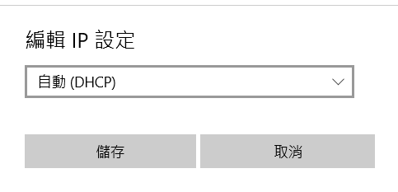
What is DHCP ?
Dynamic Host Configuration Protocol (簡稱DHCP)
提供的服務:
用於內部網路或網路服務供應商自動分配IP位址給使用者

Slide 3
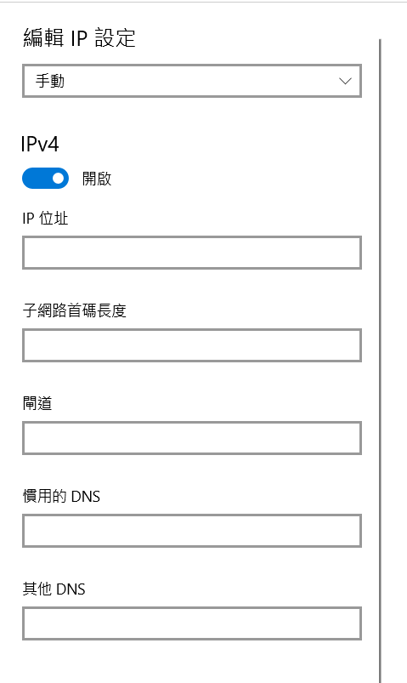
Why do we use DHCP?
IP Address
Subnet Mask
Default Gateway
Windows設定ip

Slide 4
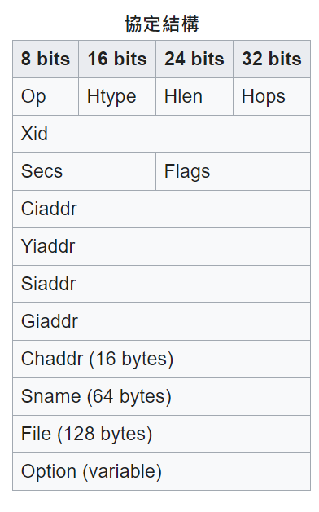
DHCP Header
Client IP address
Your IP address
DHCP
Gateway IP address
Client Mac address
DHCP Server : port 67
DHCP Client: port 68

Slide 5
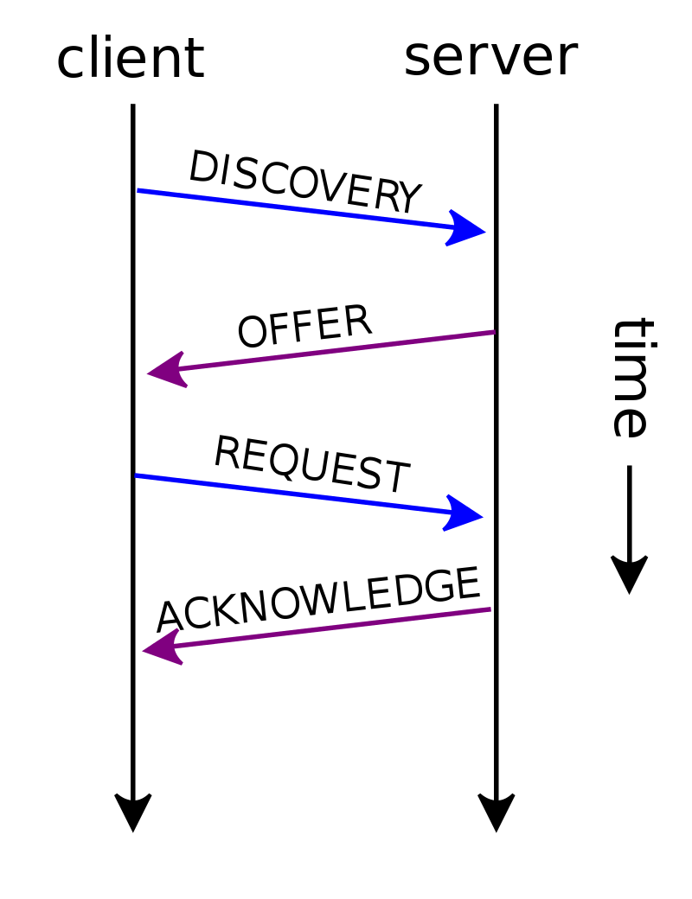
DHCP過程
DHCP DISCOVER:
尋找DHCP Server
Source IP : 0.0.0.0
Destination IP : 255.255.255.255
Broadcast
2. DHCP OFFER:
提供IP Address
利用ARP(Address Resolution Protocol)探測此IP是否有人使用

Slide 6
DHCP過程
3.DHCP REQUEST:
ARP探測是否有人使用
向DHCP Server告知使用此IP Address
4. DHCP ACK:
Server 回應確認
此IP正式開始使用

Slide 7
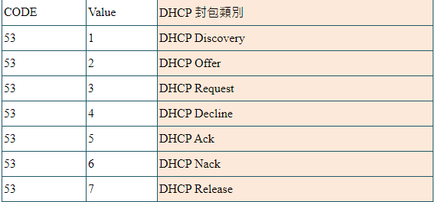
其他的DHCP 指令
DHCP RELEASE:
釋放此IP Address
DHCP NAK:
伺服器回覆客戶，客戶要求的網址不能被分配
DHCP DECLINE :
當客戶端發現伺服器分配的IP位址無法使用，則送出此訊息

Slide 8
Relay Agent
DHCP 是靠Broadcast方式傳送封包，所以當Server與Client不在同一個網段中， Server是收不到Client的request

Slide 9
Relay Agent
請Router幫忙轉送DHCP封包，此Router就稱為Relay Agent
Cisco Router指令:ip helper-address { DHCP Server IP }
Relay Agent

Slide 10
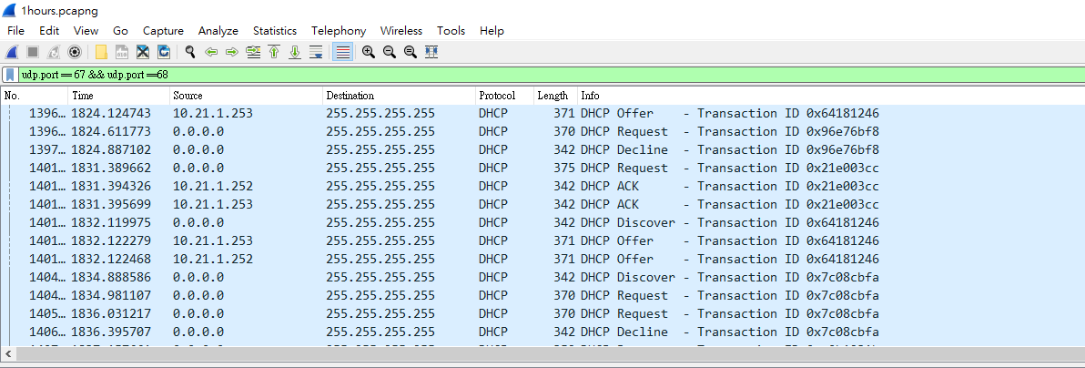
WireShark to Capture DHCP 封包
使用WireShark 在409聽VLAN21
時間:1個小時
共抓到276869個封包，其中DHCP封包共 2196個 (0.8%)
Wireshark record

Slide 11
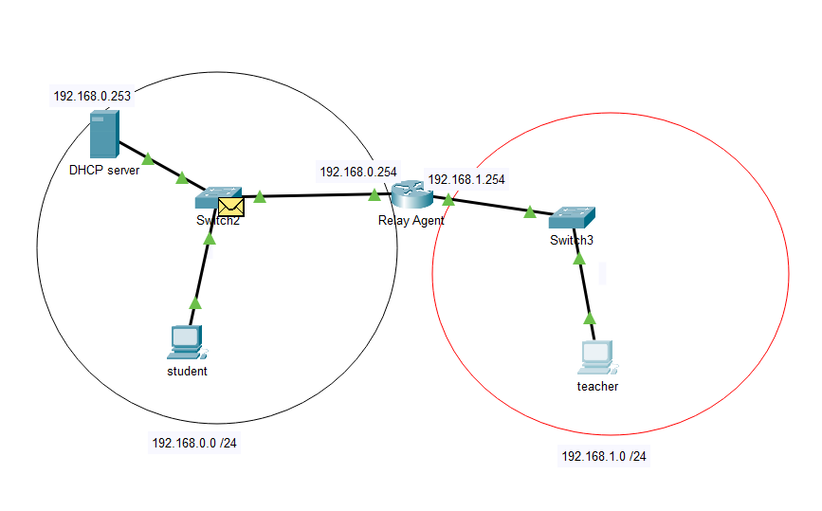
Lab 1 :DHCP Server實作
TOPO:
PT Download

Slide 12
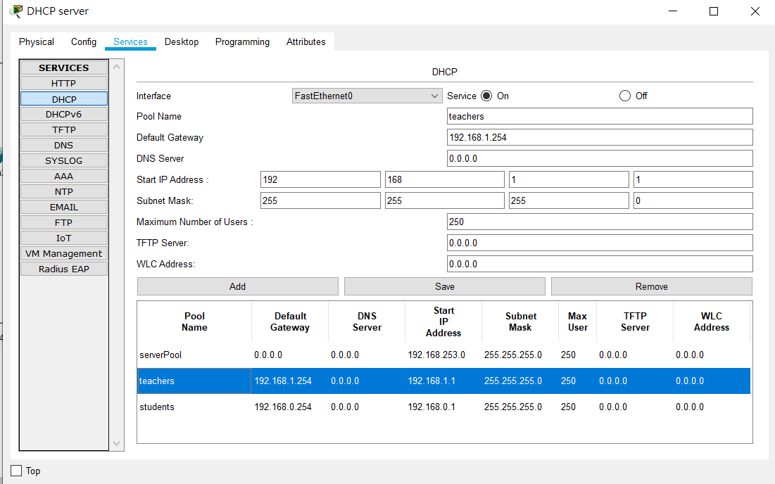
Server Configure

Slide 13
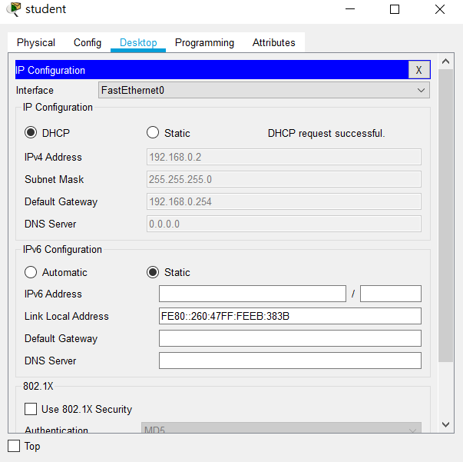
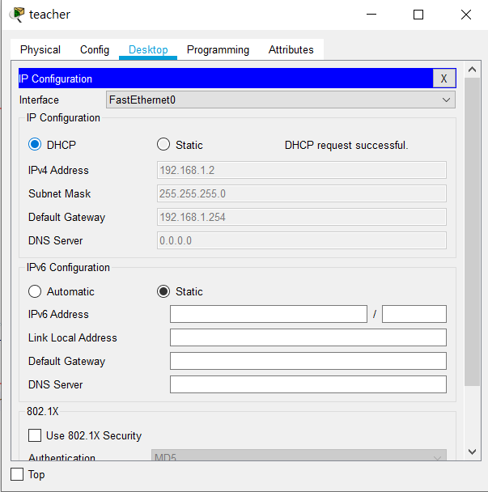
Student :
192.168.0.0 /24
Teacher :
192.168.1.0 /24

Slide 14
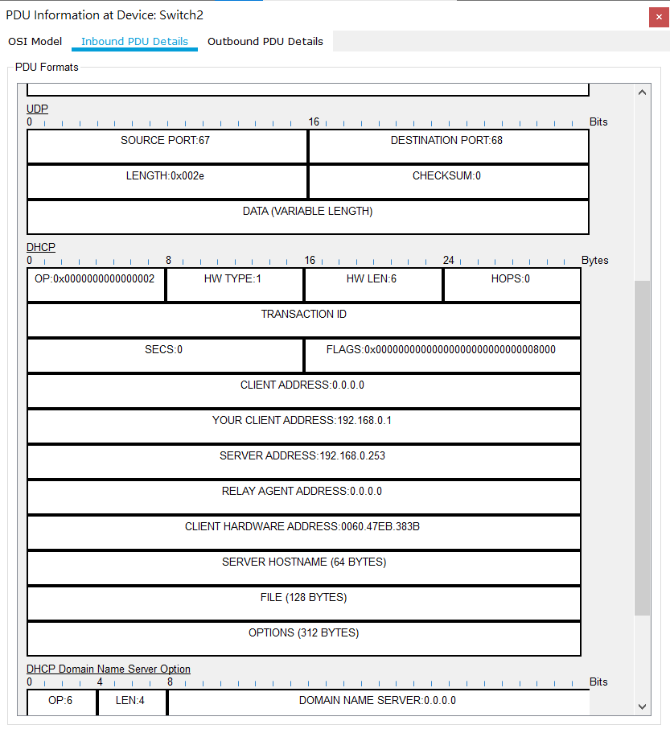
DHCP OFFER to Student

Slide 15
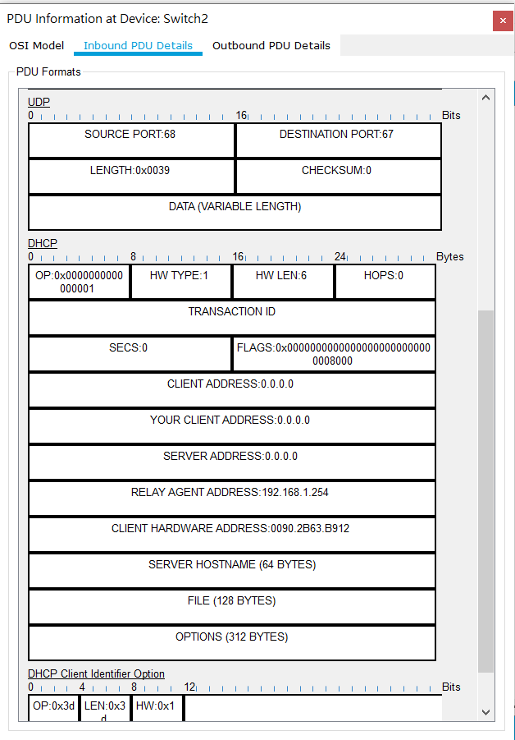
DHCP DISCOVER FROM Teacher

Slide 16
Lab 2 :Multiple DHCP Server
新增1台 DHCP Server (Server 2)
兩個 網段 192.168.0.0 /24 以及 192.168.1.0 /24
Main Server :負責80%的IP address
( 1 -200 )
Server 2 :負責20%的IP address
( 201-250)
Main Server :
Server 2 :
PT Download

Slide 17
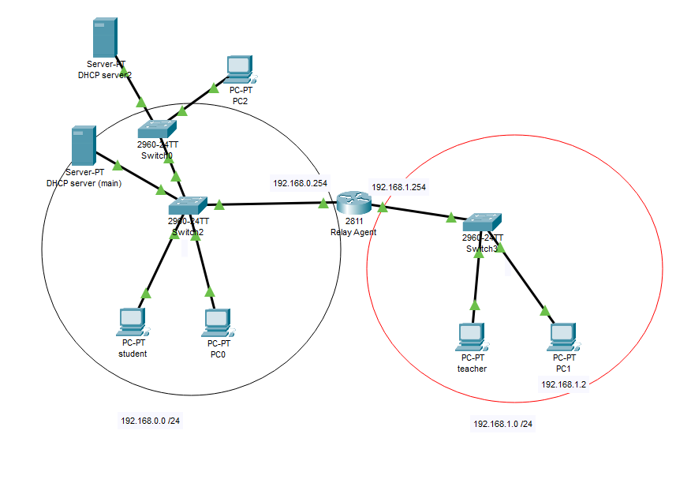
Lab 2 :Multiple DHCP Server
192.168.0.205
From Server 2
Server 2
192.168.0.252
Main Server
192.168.0.253
192.168.0.4
192.168.0.8
192.168.1.197
192.168.1.2
From Main Server
Main Server:
Server 2 :

Slide 18
If Main Server shut down
192.168.0.203
Server 2
192.168.0.252
192.168.0.205
192.168.0.204
192.168.1.217
192.168.1.218
Main Server:
All DHCP from Server 2
Server 2 :

Slide 19
Q & A

