Slide 1
Standard Operating Procedure & Revision Control System
107214005 田蕙瑜

Slide 2
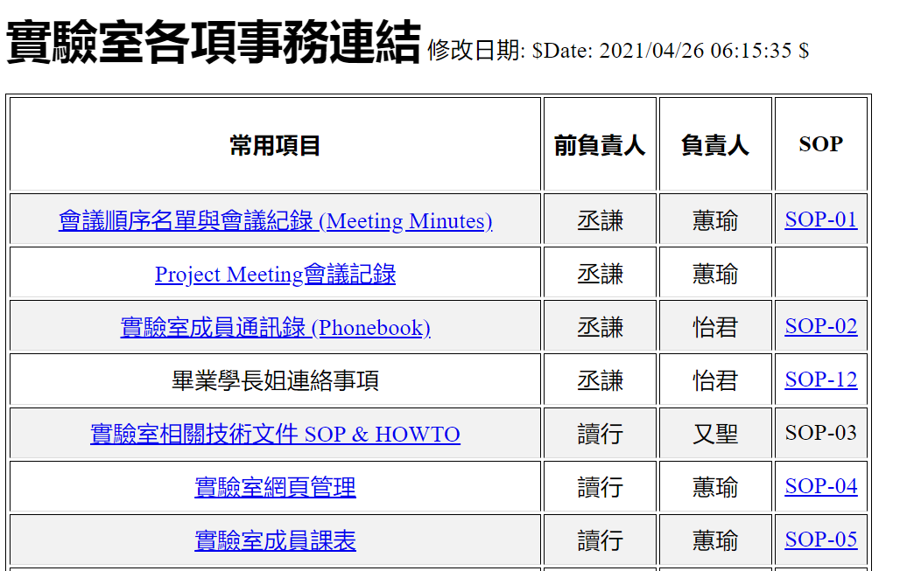
SOP (Standard Operating Procedure)
網址: http://ms15.voip.edu.tw/~manager/secure/index.htm

Slide 3
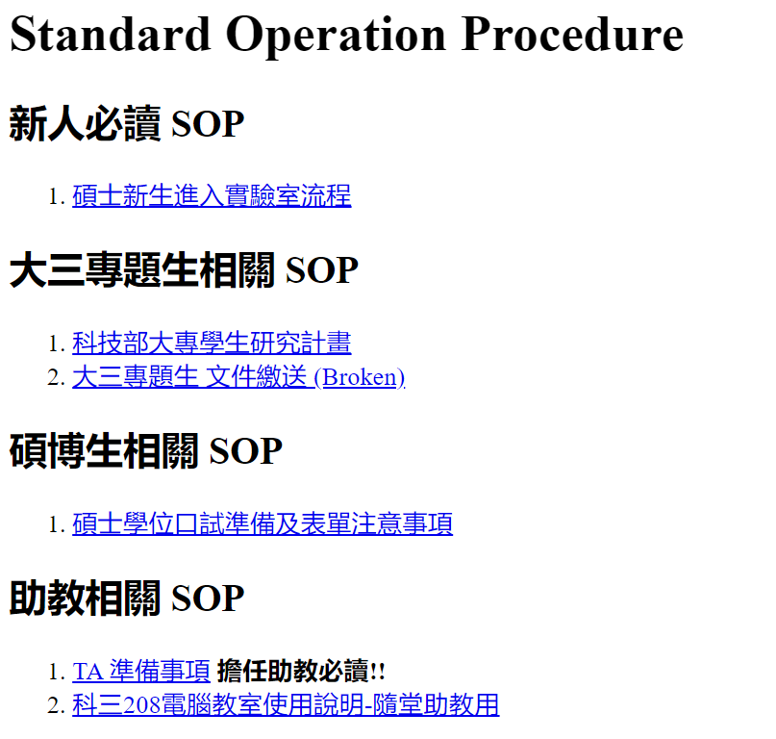
SOP (Standard Operating Procedure)

Slide 4
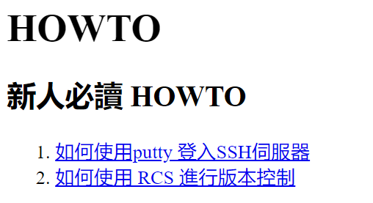
HOWTO vs SOP

Slide 5
RCS (Revision Control System)
RCS operates only single files,
so not working with an entire project.
RCS file (archive file)
<file_name>,v

Slide 6
RCS (Revision Control System) - command
ci <filename>, check in a file
deposits the contents of a file into an RCS file
co <filename>, check out a file
retrieves revisions from an RCS file

Slide 7
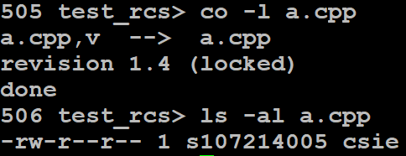
RCS (Revision Control System) – command
co -l <filename>, check out and lock a file
需要修改版本時可用
ci -l <filename>, check in and lock a file
連續修改版本時可用

Slide 8
RCS (Revision Control System) - command
rcsclean
rcsclean - clean up working files
mkdir RCS
repository 檔 (,v) 可以和 source file 在同一個 directory,
也可以另建一個 RCS 目錄
Notes:
repository 檔 (,v) 可以和 source file 在同一個 directory, 也可以另建一個 RCS 目錄

Slide 9
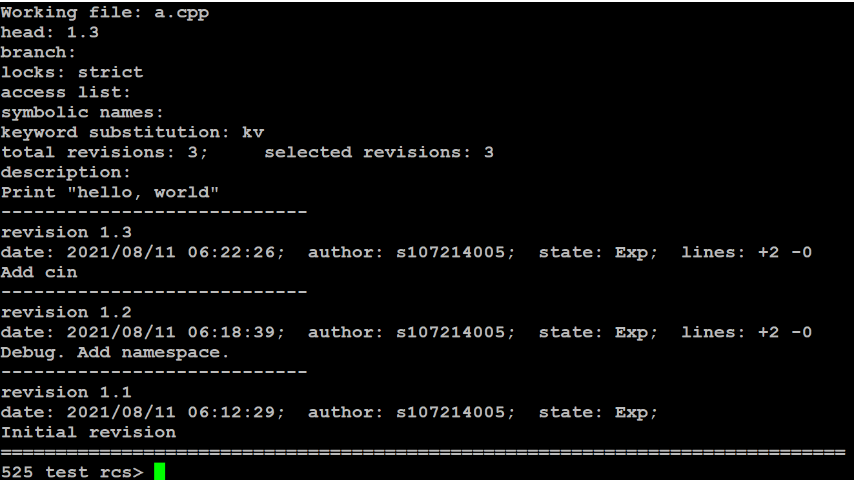
RCS (Revision Control System) - command
rlog
print log messages and other information about RCS files
rcs –m< revision >:”<comment>”
Notes:
Add –m modified log msg

Slide 10
RCS (Revision Control System) - command
rcsdiff, compare RCS revisions

Slide 11
RCS (Revision Control System) - Keyword
$Id$
A standard header of the RCS file
$Log$
The log message supplied during checkin.
$Revision$
The revision number assigned to the revision.
Notes:
https://linux.die.net/man/1/ident

Slide 12
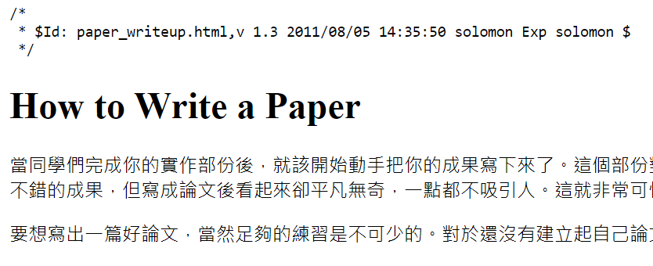
RCS (Revision Control System) - Keyword
$Author$, The login name of the user who checked in the revision.
$Date$, The date and time (UTC) the revision was checked in.
$Header$
A standard header containing the full pathname of the
RCS file, the revision number, the date (UTC), the
author, the state, and the locker (if locked).
$Id$, Same as $Header$, except that the RCS filename is without a path.
$Locker$, The login name of the user who locked the revision (empty if not locked).
$Log$, The log message supplied during checkin,.
$RCSfile$, The name of the RCS file without a path.
$Revision$, The revision number assigned to the revision.
$Source$, The full pathname of the RCS file.
$State$, The state assigned to the revision with the -s optionof rcs(1) or ci(1).
Notes:
https://linux.die.net/man/1/ident

Slide 13
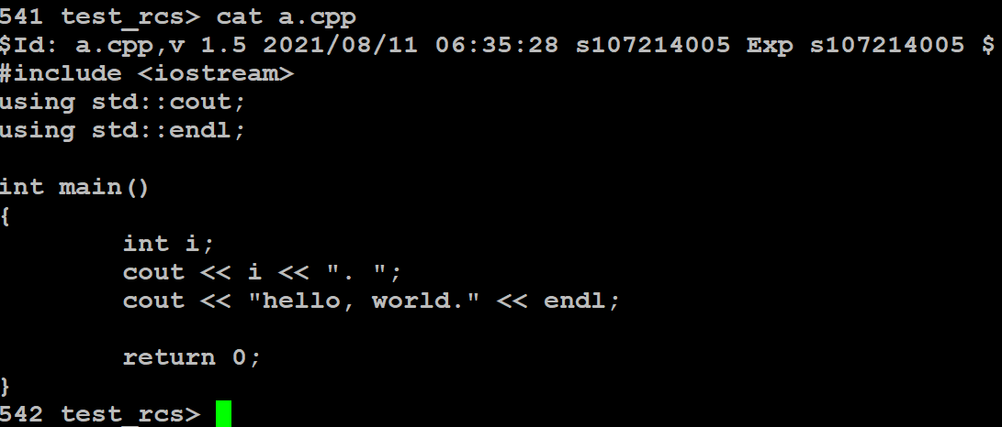
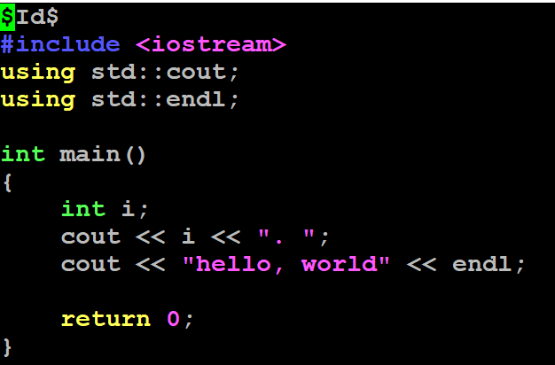
RCS (Revision Control System) - Keyword

Slide 14
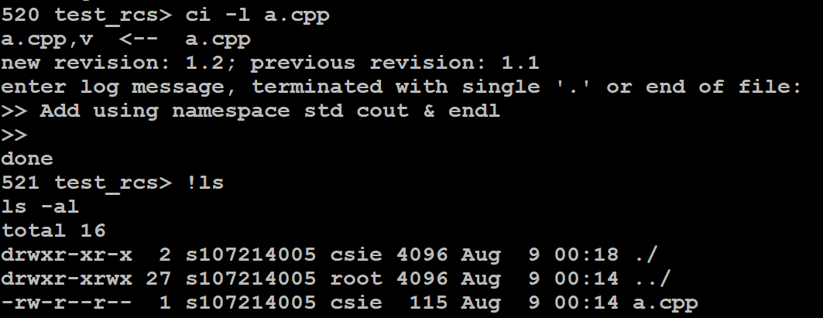
RCS (Revision Control System) - options
-l
Check in and lock.
-r<rev>
Check in revision <rev>.
Notes:
P.11 指定 revision 來 check out, 接下來就會面臨 branch 以及如何 merge 的問題，要說明。

