Slide 1
自我介紹與研究計畫
田蕙瑜

Slide 2
學經歷
(13/56)
(19/62)
(20/57)
(18/54)
(25/57)
(36/62)
就讀於財務金融學系
修習通識課程「 Python 程式設計 」期末成績 95
擔任選修課「Python 程式語言在財金上的應用」助教
修習資工系必修「程式設計」
轉系至「資訊工程學系」
成立國際計算機組織 ACM全台第一個學生分會並擔任秘書長
參加 APAC HPC-AI Competition，完成 COVID-19 Chatbot
擔任 ACM NCNU 學生分會第二屆會長
與國網中心合作協辦寒假資安培訓營
修習「Flask 網頁程式設計」，並以承接國企系同學委託網站開發作為期末專題
擔任必修課「程式設計」助教
暑期參與APAC RDMA Programming Workshop and Hackathon

Slide 3
Session Initiation Protocol Forking 機制之研究 與臨床護理之應用

Slide 4
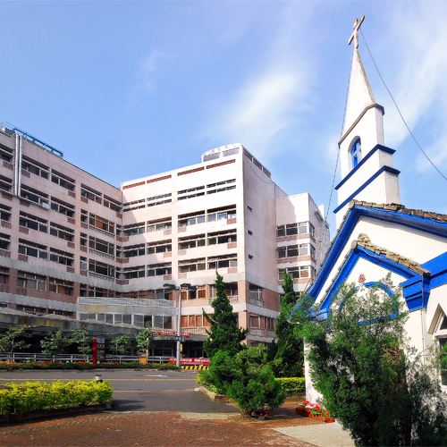
Motivation
ICT(Information and Communication Technology)
整合 – 利用客製化的網路通訊系統
資訊系統:
目前值班護士都配有智慧手機，
以QR Code 掃描病人手環與各項單據。
通訊系統: 電話交換機
解決二個問題:
值班通訊分組 Any Call
口頭醫囑 Call out with recording

Slide 5
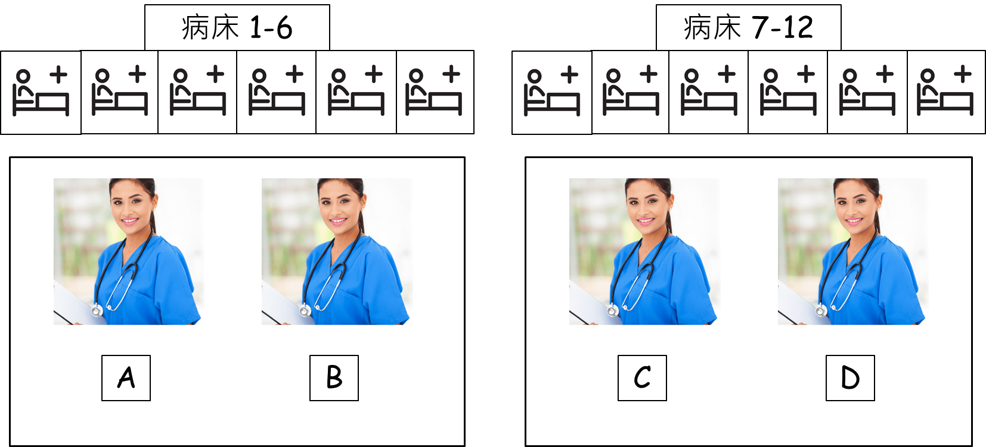
Goal 1 Any Call – Problem & Solution
夜間值班時，人力不足，卻必須有護理師在護理站待命。
SIP Forking
醫生要確認病人情況，只能自行查找該日該時段的值班表
Web API 抓取資料，每小時更新一次
現有的傳統交換機只能記錄接通到通話結束的時間
Call log

Slide 6
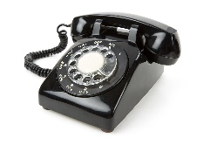
Goal 1 Any Call –
System Architecture and SIP Forking
Call log
Web API
SIP
Server
Avaya
PBX
PCH
FXO Gateway
護理站
A
B
C
D
群組一
群組二

Slide 7
SIP Forking
SIP Server
醫師
護理師 A
護理師 B
情境:
護理師A & 護理師B 皆屬於群組一，當醫師撥打群組一的號碼時
Server fork 2 request
=> INVITE will be forked.
INVITE
INVITE
INVITE
100Trying
180 Ringing
180 Ringing
180 Ringing
180 Ringing
200 OK
200 OK
ACK
ACK
CANCEL
200 OK
487
Request
terminated
ACK

Slide 8
Waiting Algorithm
Start
病人撥打群組n
Yes
撥通 T 秒後確認，
群組n 是否接通
將群組n 成員還原為初始狀態
No
將群組n+1 加入群組n 進行撥號
將群組n+1 加入群組n 進行撥號
END

Slide 9
Thank you!

Slide 10
Goal 2 : Call out – Problem & Solution
Problem:
護理人員以電話向醫師說明病人狀況，醫師口頭囑咐予以注設或口服藥劑。依醫療法於24小時內完成書面紀錄。
夜間值班人力有限，難以做到在口頭醫囑下達時，電話旁均有人進行複誦及確認。
只有管理者可以調閱紀錄檔。
Solution:
擬將所有經本系統撥出之電話通訊，自動錄音存檔。護理人員可於資料庫中調出語音檔，納入病歷資料中。

Slide 11
Call out – System Architecture
Audio Recorder
Mobile
Operators
SIP
Server
Avaya
PBX
PCH
FXO Gateway
護理站
A
B
C
D
群組一
群組二

Slide 12
What is SIP?
SIP is an application-layer control protocol,
establishing and terminating multimedia communications
SIP is not a vertically integrated communications system.
HTTP-like，由request & reposes(status code) 組成。
Source
Destination
Info.
[註] Client IP: 10.21.22.197; SIP Server IP: 163.22.20.111
Notes:
@1:11:37
POST&GET
404 not found

Slide 13
A SIP Call: Chris called Bob, Bob answered and hung up
SIP Server
163.22.20.111
Chris
10.21.22.197
Bob
10.21.24.21
INVITE
INVITE
100Trying
180 Ringing
180 Ringing
200 OK
200 OK
ACK
ACK
BYE
BYE
200 OK
200 OK
Notes:
# After BYE,
# 例如: IVITE我們正在I180Ring我們正在處裡訂單：200OK訂單有貨

Slide 14
SIP Message — Request or Response
Request:
REGISTER, INVITE, ACK, BYE, CANCEL, MESSAGE etc.
Response(Status code):
1xx: Provisional; 2xx: Success; 3xx: Redirection
4xx: Client Error; 5xx: Server Error; 6xx: Global Failure
Source
Destination
Info.
[註] Client IP: 10.21.22.197; SIP Server IP: 163.22.20.111
Notes:
The interpretation of the body depends on the request method.
All responses MAY include a body.
舉例來說，通常Request INVITE會有body to give interpretation of devices
---
1xx: Provisional
-- request received, continuing to process the request;
2xx: Success
-- the action was successfully received, understood, and accepted;
3xx: Redirection
-- further action needs to be taken in order to complete the request;
4xx: Client Error
-- the request contains bad syntax or cannot be fulfilled at this server;
5xx: Server Error
-- the server failed to fulfill an apparently valid request;
6xx: Global Failure
-- the request cannot be fulfilled at any server.

Slide 15
Transaction
Def. a SIP transaction consists of a single request and any responses to that request
Type:
INVITE Transaction: It consists of a three-way handshake.
Non-INVITE Transaction: It do not make use of ACK.
Notes:
The INVITE transaction consists of a three-way handshake.
The client transaction sends an INVITE, the server transaction sends responses, and the client transaction sends an ACK.
Non-INVITE transactions do not make use of ACK.

