Slide 1
The Psychology of How Novices Learn Computer Programming
RICHARD E. MAYER
Department of Psychology,
University of California

Slide 2
Outline
What is Meaningful Learning?
3 Steps of Meaningful Learning
Meaningful Learning vs Rote Learning
2 Methods of Meaningful Learning
Concrete Model
Elaboration, put it in your own words
Understanding the program – Experts knows but novices don’t
Summary

Slide 3
What is meaningful learning?
Meaningful Learning (Assimilate new information to schema)
a process that the learner can connect new materials with existing acknowledge
Schema, the existing knowledge
Assimilation, the process of connecting new information to the schema
new
information
connecting
schema
Assimilate new information to schema

Slide 4
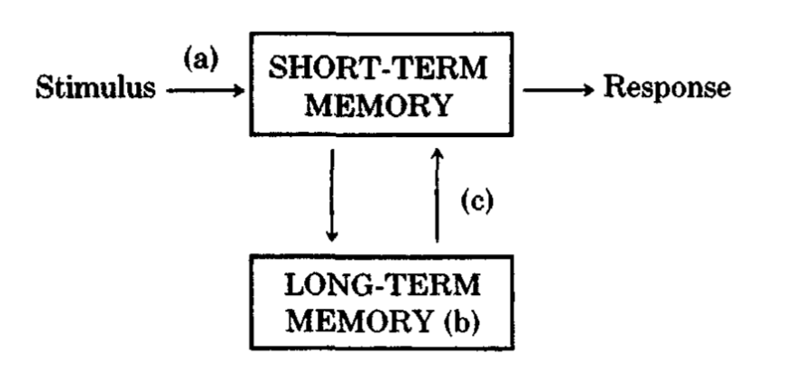
Cognitive System
Cognitive System
Short-term memory
temporary
limited capacity
Long-term memory
permanent
unlimited capacity

Slide 5
3 Steps for Meaningful Learning to occur
Reception
Incoming information reaches short-term memory (a)
appropriate anchoring ideas
Availability
Possessing prerequisite concepts in long-term memory (b)
Activation
Actively use prerequisite knowledge during learning (c)
Meaningful
Learning

Slide 6
What is Meaningful Learning? - Meaningful Learning vs Rote Learning
Meaningful Learning
Explore the parallelogram visually
Rote Learning
Give the formula :
Area = Height x Base
Both groups do well in involving test
But rote learning group cannot pass the transfer test
Notes:
how to increase the novice’s understanding
how to foster meaningful learning of computer concepts by novices

Slide 7
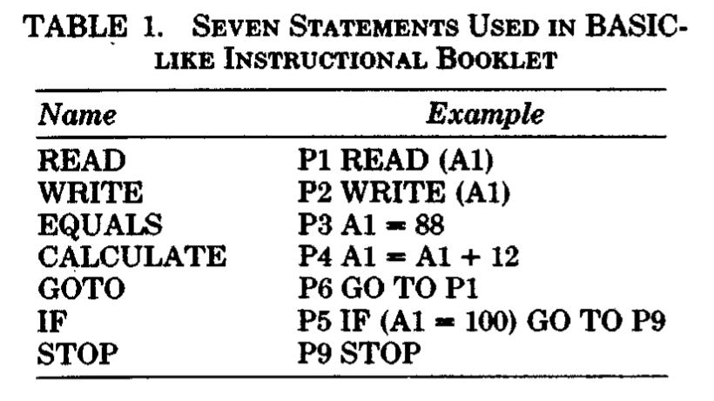
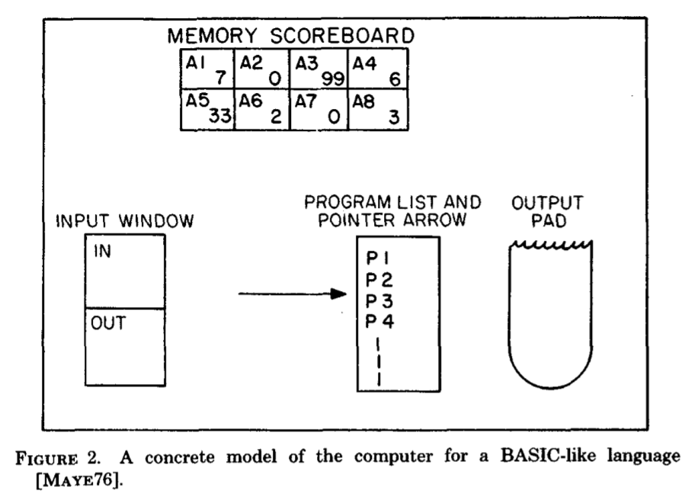
2 Methods of Meaningful Learning - Concrete Model : Experiment
The concrete model(figure 2.) includes 4 major function:
Input
Output
Memory
Executive Control
2 Groups:
Model
(with the concrete model)
Control
(without the concrete model)

Slide 8
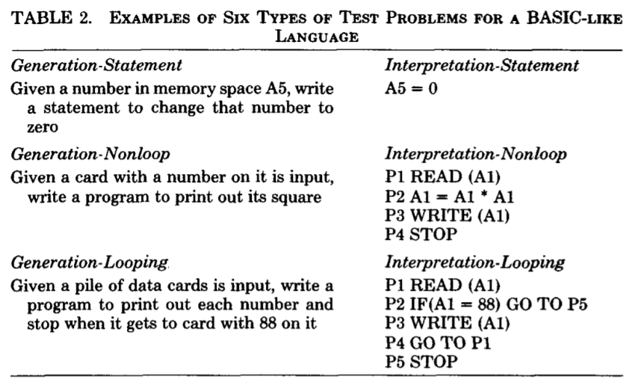
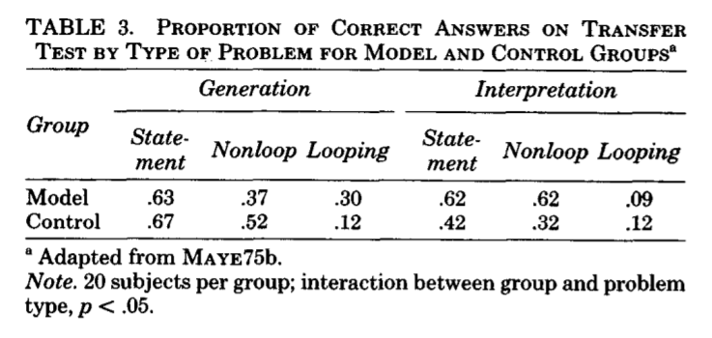
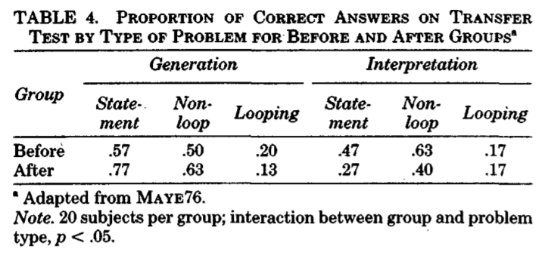
2 Methods of Meaningful Learning - Concrete Model : Experiment

Slide 9
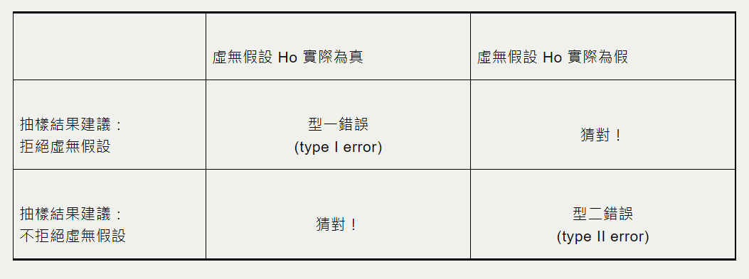
Statistics
Problem: Does providing the concrete model has effects on learning computer programming?
H0 ( Null Hypothesis ) : No effects.
H1 ( Alternative Hypothesis ) : Yes, it does.
p-value:
the possibility of type 1 error
p < 0.05(5%)
可信

Slide 10
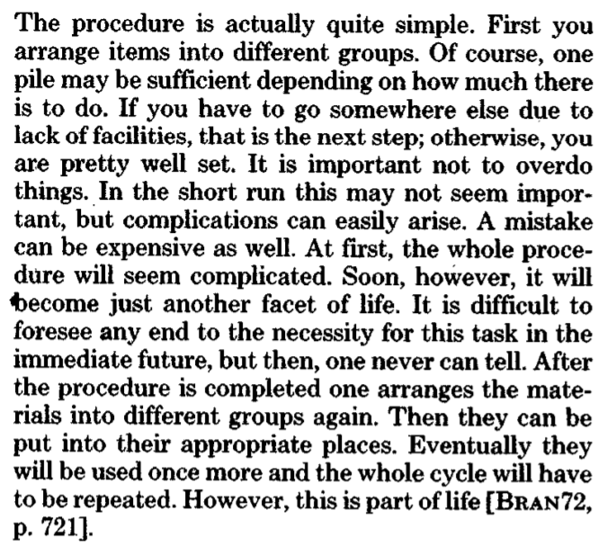
2 Methods of Meaningful Learning - Concrete Model : Advance Organizer
Title : Washing clothes
Strong effects for unfamiliar, abstract information(info)
Guidelines:
Allow the learners to generate the logical relation
Provide a means of relating the info with existing knowledge
Be familiar to the learner
Encourage the learners to use prerequisite knowledge which normally have used

Slide 11
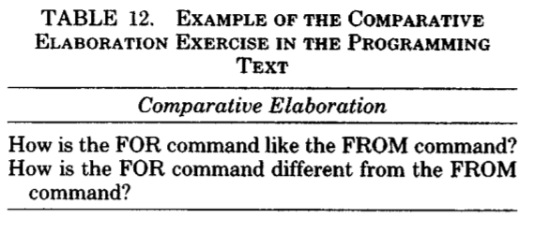
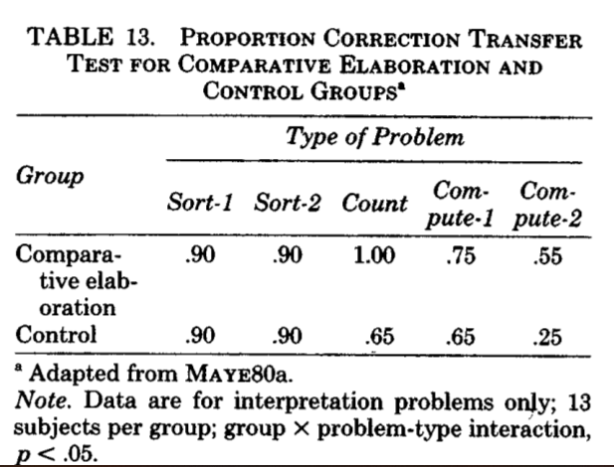
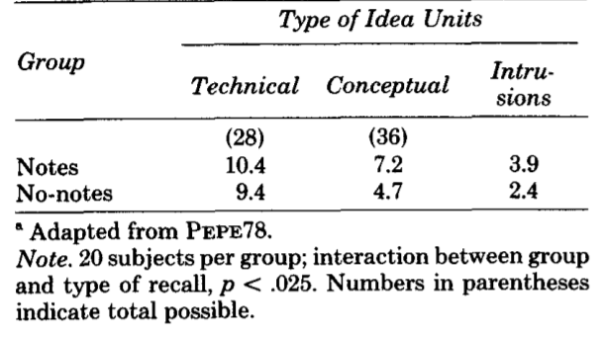
2 Methods of Meaningful Learning - Elaboration
Putting technical information into your own words
By doing comparative elaboration exercise
By noting
Notes:
The Feynman Technique
https://youtu.be/tkm0TNFzIeg

Slide 12
Understanding a Program – Experts knows but novices don’t
Experts know but novice not
understanding a statement
understanding a program
All problem solving is based on knowledge
A person needs 50,000 chunks of domain-specific information to become an expert
=> teach basic chunks/schemata to novices

Slide 13
Summary
Availability(b)
Meaningful Learning
Elements
Meaningful
Learning
Reception
(a)
Activation
(c)
Methods
How to teach novices
Concrete Model
Elaboration
&
What to teach novices
understanding
a statement
understanding
a program
&
Thank you!

Slide 14
Reference
The Psychology of How Novices Learn Computer Programming
RICHARD E. MAYER
https://dl.acm.org/doi/pdf/10.1145/356835.356841
What is a P-value?
Cave & C. Supakorn
http://www.biosci.global/customer-stories-en/what-is-a-p-value/
統計術語小教室：你說的是真的嗎？
https://talkecon.com/statistics101/
統計學:大家都喜歡問的系列-p值是什麼
https://chih-sheng-huang821.medium.com/統計學-大家都喜歡問的系列-p值是什麼-2c03dbe8fddf
淺談 p-value 的濫用
王博賢 陳錦華
http://libir.tmu.edu.tw/bitstream/987654321/57393/2/21-01%20淺談p值.pdf

