Slide 1
RFC 3489 - STUN
Simple Traversal of User Datagram Protocol (UDP) Through Network Address Translators (NATs)
107214005田蕙瑜

Slide 2
ABSTRACT

Slide 3
ABSTRACT
STUN
Simple Traversal of User Datagram Protocol (UDP) Through Network Address Translators (NATs)
A lightweight protocol
Allows applications to discover the presence and types of NATs and firewalls between them and the public Internet.

Slide 4
BACKGROUND

Slide 5
BACKGROUND
NAT can not work in Peer-to-peer protocols
e.g. Multimedia communication, file sharing
Middlebox Communications (MIDCOM) protocol
allows an application entity to control a NAT
like a Session Initiation Protocol (SIP) proxy

Slide 6
NAT VARIATIONS

Slide 7
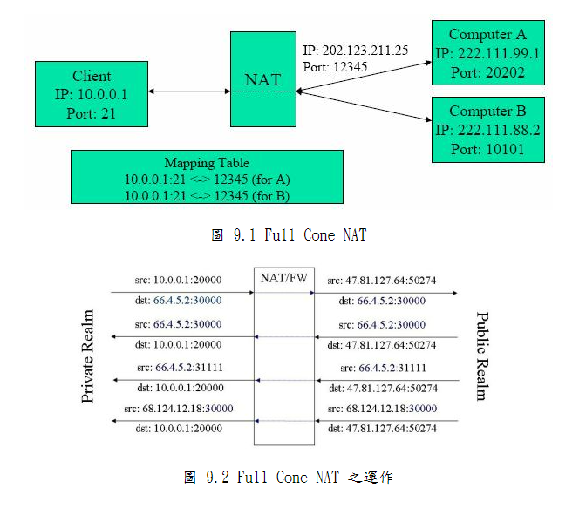
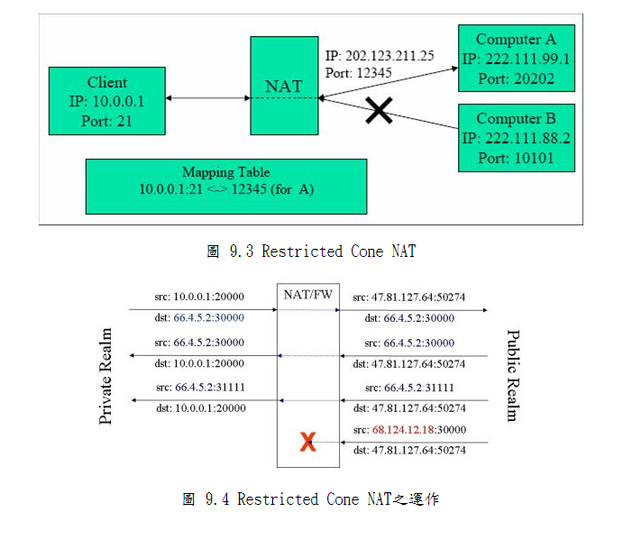
NAT VARIATIONS
Notes:
http://www.cs.nccu.edu.tw/~lien/Writing/NGN/firewall.htm

Slide 8
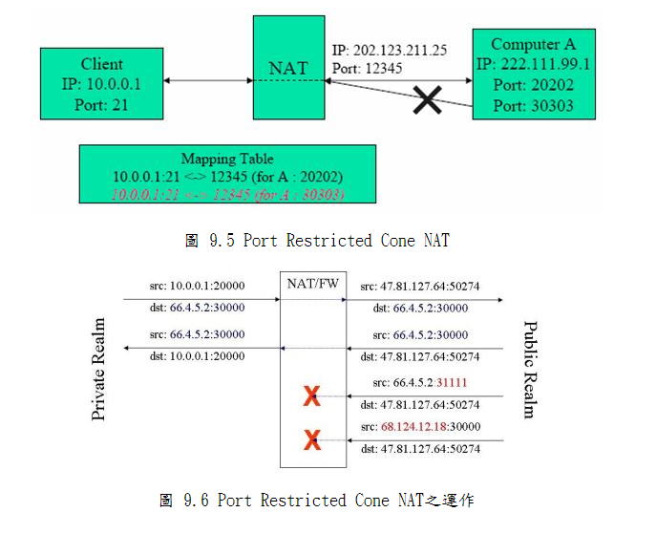
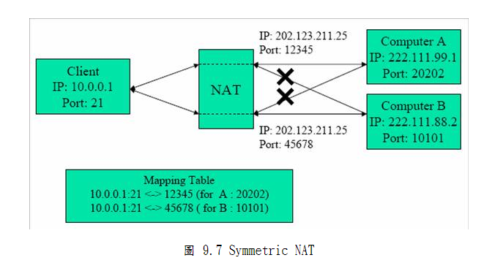
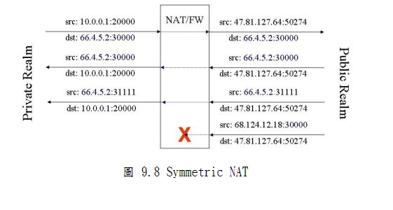
NAT VARIATIONS
Notes:
http://www.cs.nccu.edu.tw/~lien/Writing/NGN/firewall.htm

Slide 9
STUN CONFIGURATION

Slide 10
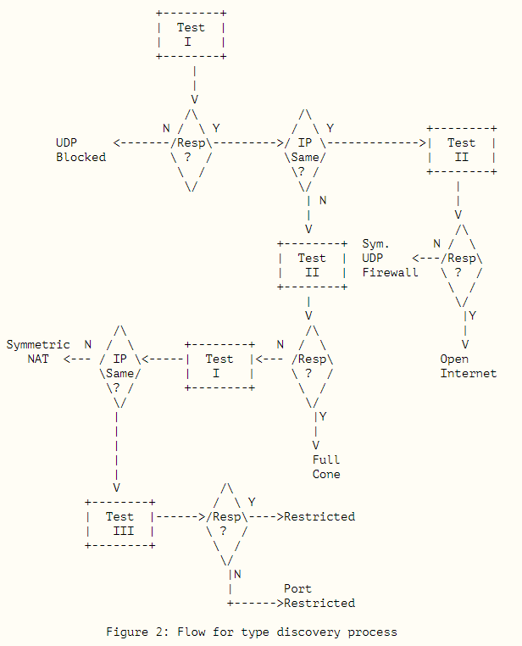
STUN ARCHITECTURE
STUN is a simple client-server protocol.
Request
Binding Request
Shared Secrete Request
TCP

Slide 11
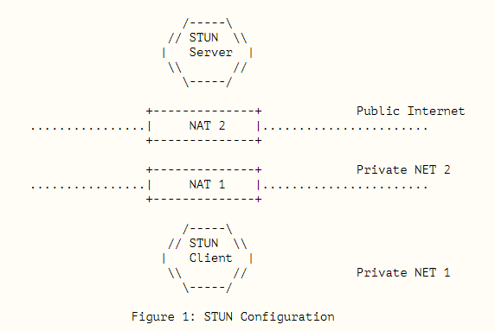
STUN ARCHITECTURE
STUN is a simple client-server protocol.
Client send the STUN Reqyest to STUN Server
STUN Server Response

Slide 12
STUN MESSAGE

Slide 13
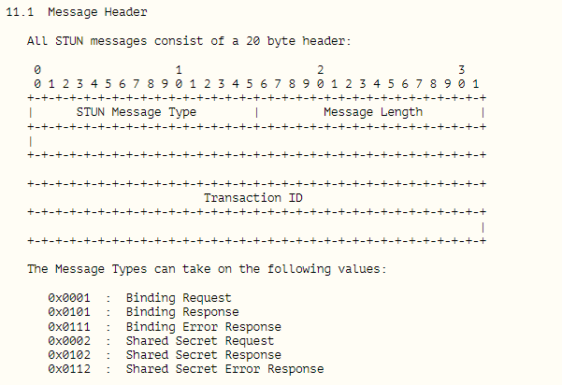
STUN MESSAGE

Slide 14
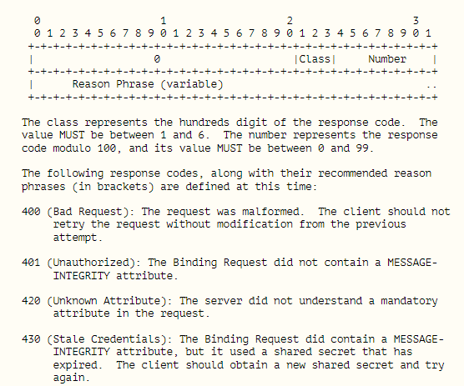
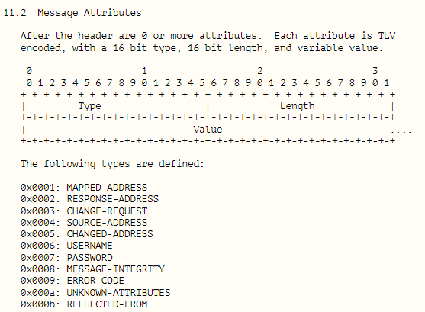
STUN MESSAGE

Slide 15
REFERENCE

Slide 16
Reference
THANKS
RFC 3489
https://datatracker.ietf.org/doc/rfc3489/
Notes:
winter is coming.get ready FOR steam winter sale.

