Slide 1
洪胤勛

Slide 2
Intro
Load testing tool
protocol supported: HTTP/1.1, HTTP/2, WebSocket and gRPC
configuration: certificates, Cookies

Slide 3
Running
command option
JavaScript (不需要 Node.js)

Slide 4
Running
virtual users
Socket.IO
users are parallel

Slide 5
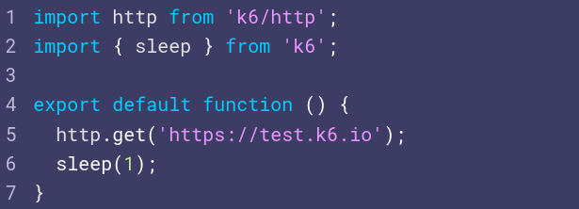
Running
exported default function
like C, main
virtual users are parallel while(true) loops

Slide 6
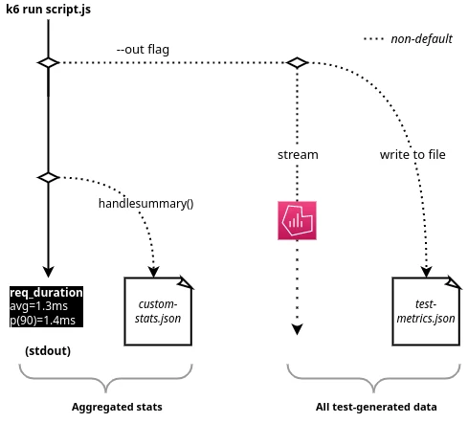
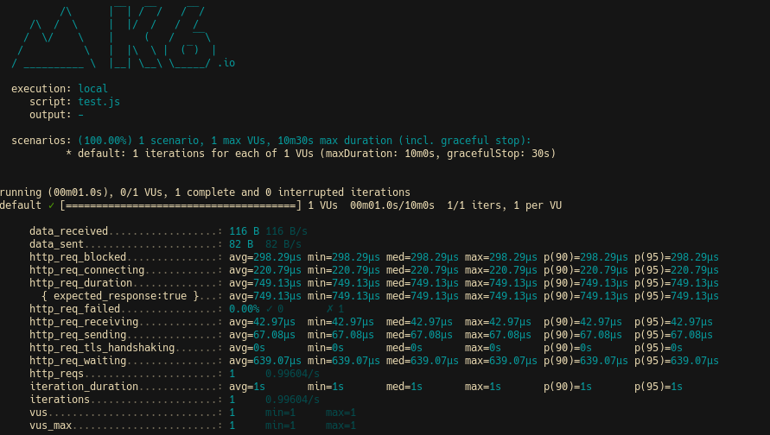
Output
ex. CSV, JSON
ex. Grafana, Datadog, Prometheus
https://k6.io/docs/using-k6/metrics/

Slide 7
Demo
(name).lab.test.ncnu.org
wget -O - http://ms15.voip.edu.tw/~branko/lab_meeting/install.sh | sh
k6, InfluxDB, Grafana

Slide 8
Demo
wget http://ms15.voip.edu.tw/~branko/lab_meeting/demo1.js
k6 run demo1.js
k6 run --vus 10 --duration 30s demo1.js

Slide 9
Demo
wget http://ms15.voip.edu.tw/~branko/lab_meeting/demo2.js
k6 run demo2.js

Slide 10
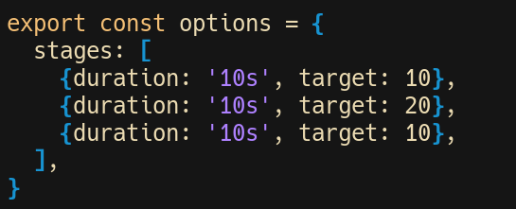
Demo
wget http://ms15.voip.edu.tw/~branko/lab_meeting/demo3.js
1 -> 10 -> 20 -> 10
(linearly)
k6 run demo3.js

Slide 11
Demo Output
k6 run --out json=test.json demo2.js
multiple output
k6 run --out json=test.json --out csv=test.csv demo2.js
https://k6.io/docs/getting-started/results-output/

Slide 12
Demo Output Grafana
k6 run --out influxdb=http://localhost:8086/k6db demo3.js

Slide 13
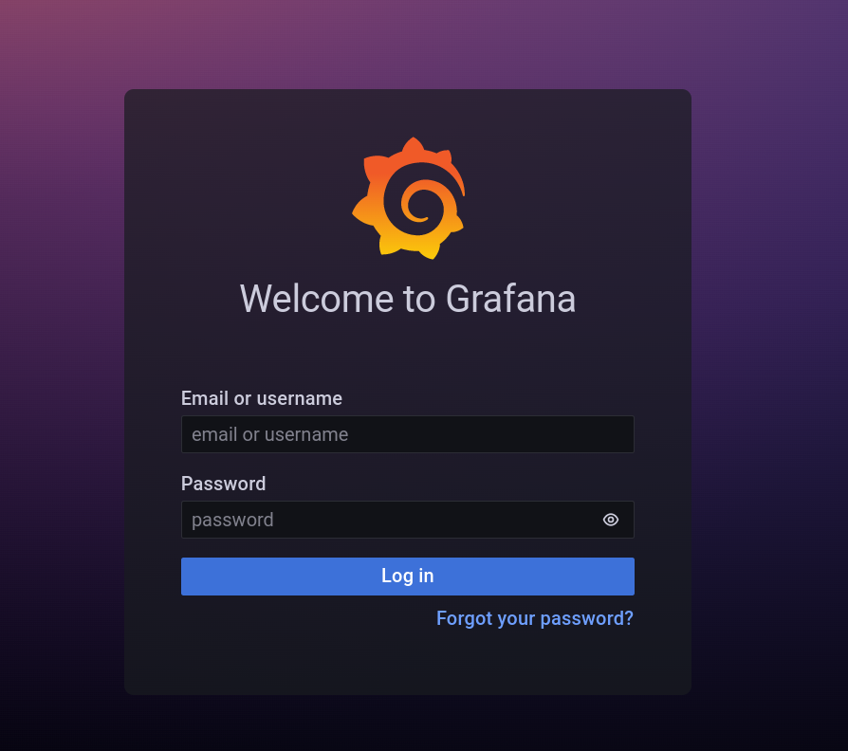
Demo Output Grafana
port 3000
admin, admin

Slide 14
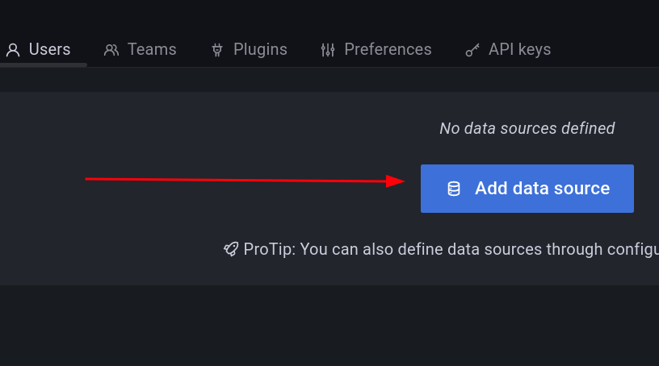
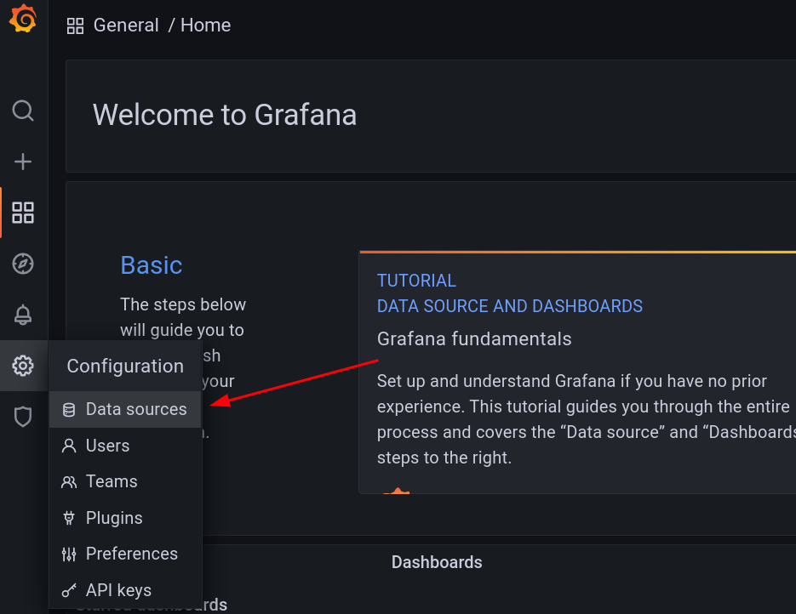
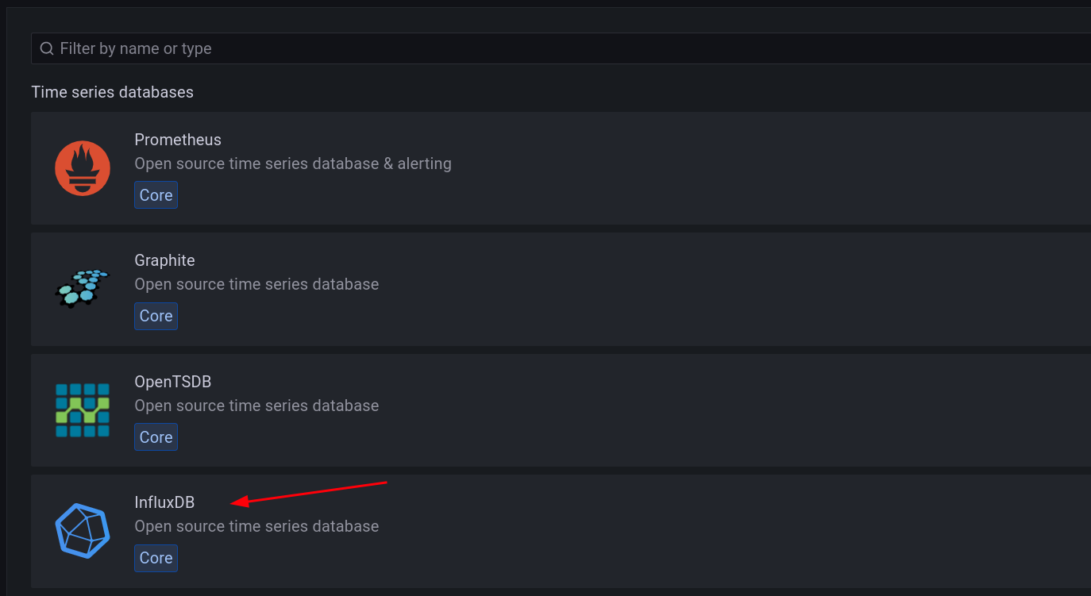
Demo Output Grafana
1
2
3

Slide 15
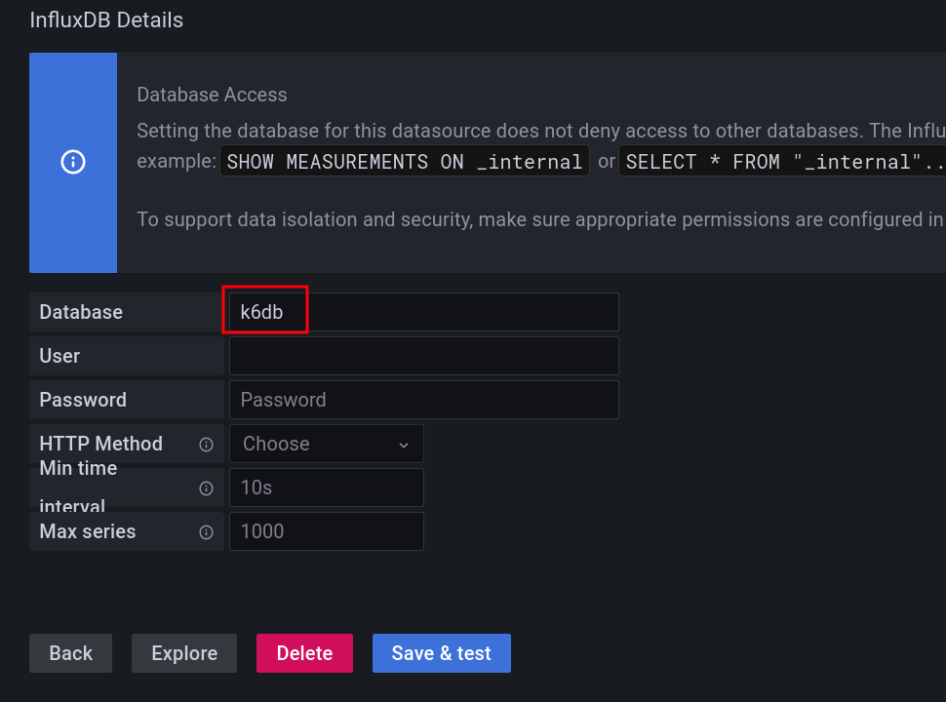
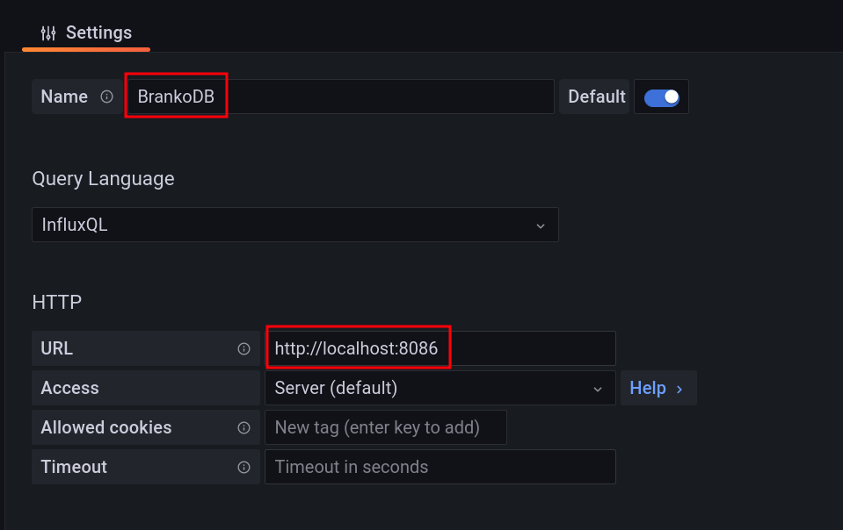
Demo Output Grafana
1
2

Slide 16
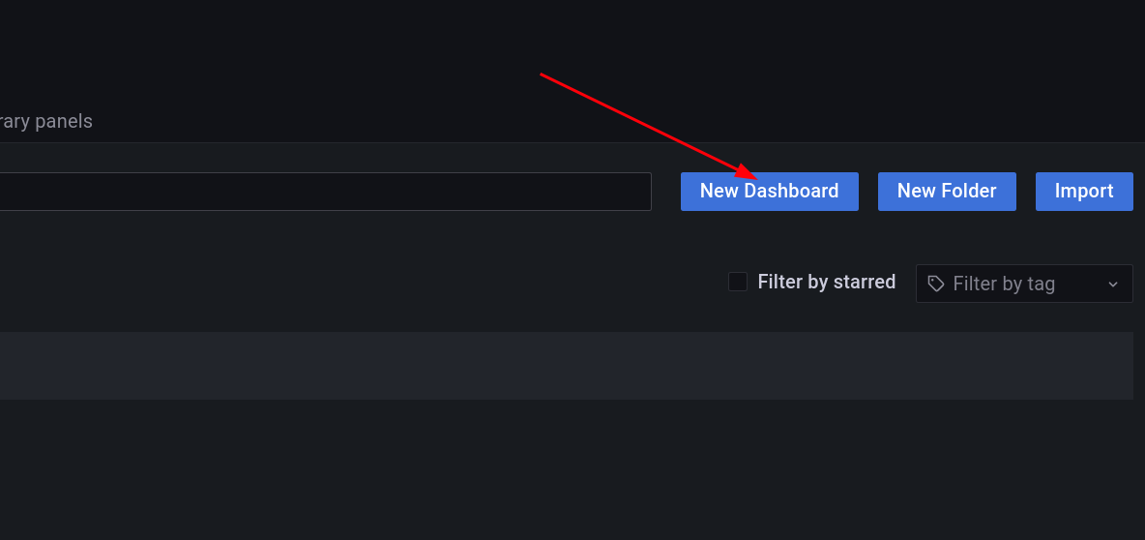
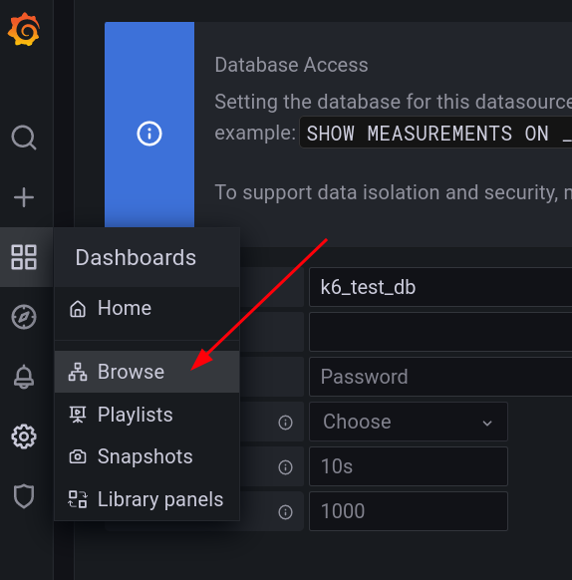
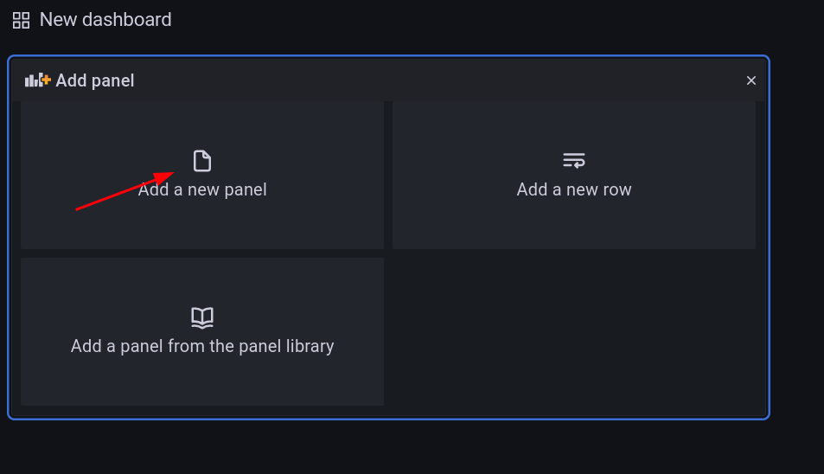
Demo Output Grafana
2
1
3

Slide 17
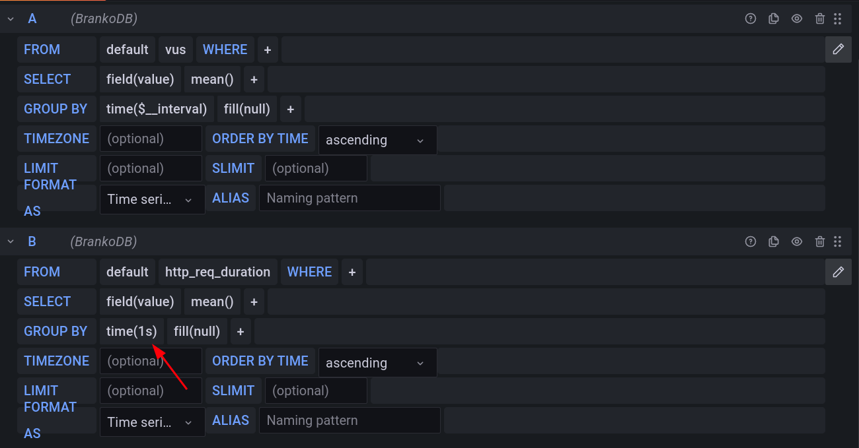
Demo Output Grafana

Slide 18
IO limit
k6 run --vus 10000 --duration 30s demo1.js
ulimit -a
ulimit -n 25000
Thank you for your listening

