Slide 1
webRTC

Slide 2
what feature does webrtc want to achieve?
Acquiring audio and video
Communicating audio and video
Communicating arbitrary data

Slide 3
little history(at the past)
corporate and complex
need expensive licenses to develop in-house
integreate RTC with other services is difficult and time-consuming
particularly on the web
google buy GIPS(Global IP Solution) and open sourced the technology
engage the webRTC standard with IETF
W3C to ensure the industry consensus

Slide 4
three main API
MediaStream (aka getUserMedia)
RTCPeerConnection
we will call it pc instead of RTCPeerConnection
RTCDataChannel

Slide 5
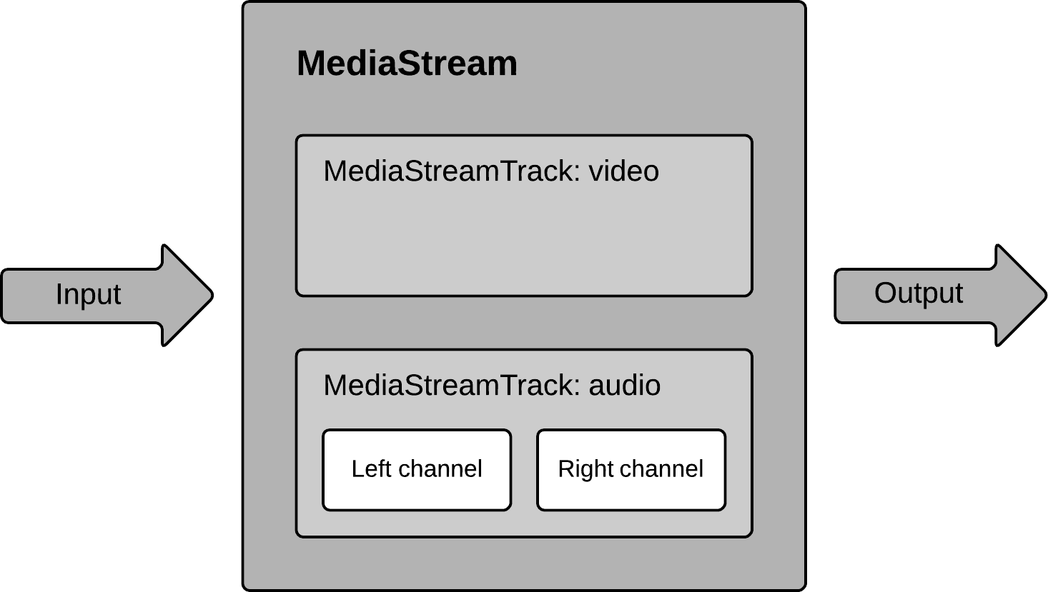
MediaStream
get the stream from browser
Obtain a MediaStream with `navigator.getUserMedia()`
may contain multi tracks

Slide 6
RTCPeerConnection
Signal processing
Codec handling
P2P communcation
Security
Bandwitdth management
…

Slide 7
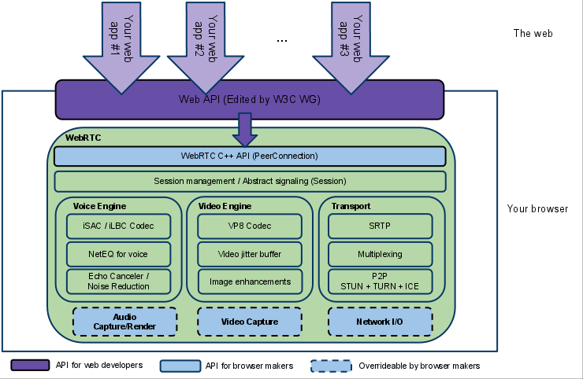
RTCPeerConnection
browser 提供簡單 api 簡化建立 p2p connection 過程
connection and ice 協商
media encoding
需要設定的項目
協商傳輸的通道
影音 stream 來源
除了提供協商通道和傳輸資料，剩下的操作被包裝在 browser

Slide 8
How to establish RTCPeerconnection
initialize
signaling
傳輸信令的通道(XMPP, WebSocket…)
constraints
media stream 的限制(寬, 高...)
pc(peer connection)
RTCPeerConnection’s instance
https://w3c.github.io/webrtc-pc/#example-9

Slide 9
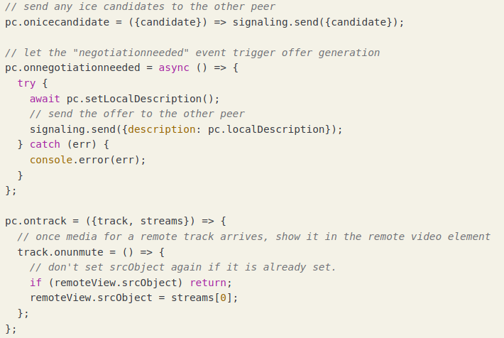
How to establish RTCPeerconnection
4 main callback
onnegotiationneeded
設定 local 的 sdp offer
等價於`pc.setLocalDescription(await pc.createOffer())`
onicecandidate
送出 local 可行網路的 sdp
onTrack: 設定傳回的 track 用途
https://w3c.github.io/webrtc-pc/#example-9

Slide 10
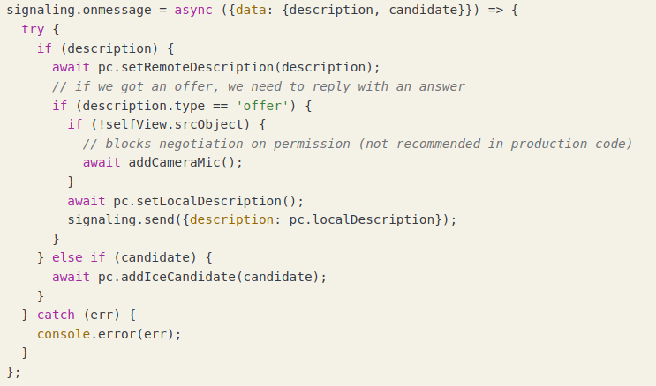
How to establish RTCPeerconnection
4 main callback
onMessage
接收 sdp offer 儲存到 pc 並產生 sdp answer 回傳給傳遞 offer 的 user
pc.localDescription 是傳遞 offer 的 user 的 sdp answer
把 candidate 加入到 pc 讓瀏覽器底層進行協商
remote description
remote canidiate
https://w3c.github.io/webrtc-pc/#example-9

Slide 11
webRTC’s behavior
Alice(Caller)
Signaling Server
Bob(callee)
web app
browser
browser
web app
crate pc
add local stream’s track to pc
ready to negotiate, so ask caller to start do so
create pc
set pc.remoteDescription by “video-offer”
add local stream to pc
create sdp-answer
set local-sdp
send sdp-answer to Alice
send offer and set local offer(pc)
trigger negotiation event
Forward video-offer to Bob
trigger message event
data: “video-offer”
data: “video-offer”
ice layer start sending candidates to Bob
set pc.RemoteDescription
trigger icecandidate event
Forward video-offer to Bob
data: “video-answer”
data: “video-answer”
trigger Message event
ice layer start sending candidates to Alice
trigger icecandidate event

Slide 12
ICE’s behavior
Alice(Caller)
Signaling Server
Bob(callee)
web app
browser
browser
web app
Generate an ICE candidate(represented by an SDP)
RTCIceCandidate (message)
add canadate to pc
send to ice candidate to peer
trigger message event
Forward candidate to Bob
trigger message event
data: “candidate”
data: “candidate”
RTCIceCandidate (message)
add the RTCIceCandidate to pc
Generate an ICE candidate(represented by an SDP)
Forward video-offer to Bob
data: “candidate”
data: “candidate”
trigger icecandidate event
trigger message event
ice layer start sending candidates to Alice

Slide 13
demo

Slide 14
demo 架構
self sign certificate
root CA
server’s certificate
root CA’s key
server’s key
Sign
import root CA
root CA’s certificate
server’s certificate
user
root CA’s certificate
docker-compose
browser
webRTC demo server
access web server

Slide 15
before start demo
get into the server(user is “your_name”, passwd is “test”)
jerry.lab.test.ncnu.org
branko.lab.test.ncnu.org
chofinn.lab.test.ncnu.org
angela.lab.test.ncnu.org
phoebe.lab.test.ncnu.org
henry.lab.test.ncnu.org
edger.lab.test.ncnu.org
solomon.lab.test.ncnu.org
clone the repo
`git clone --recursive https://github.com/efficacy38/webRTC_pearl.git`
replace some setting
`perl -i -pe "s/lab.test.ncnu.org/${USER}.lab.test.ncnu.org/g" ./webrtc/index.html ./docker-compose.yml ./ssl.ca/new-server-cert.sh`
`cd ./webrtc`

Slide 16
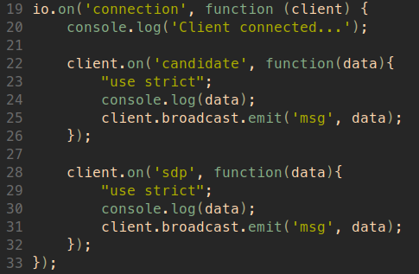
web 架構
使用 ssl
ssl/privkey.key
ssl/server.crt
向另一方傳送資料
sdp candidate
sdp answer/offer
build our’s server inage
`docker build -t webrtc-demo . `

Slide 17
self sign certificate
install the certificate helper
`cd ../ssl.ca && ./install.sh`
generate ssl workspace
`mkdir ../ssl && cd ../ssl`
generate ssl root certificate
`new-root-certificate`
generate ssl server certificate
`new-server-cert {YOUR_NAME}.lab.test.ncnu.org`
use root certificate to sign the server’s certificate
`sign-server-cert {YOUR_NAME}.lab.test.ncnu.org`

Slide 18
import self sign certficate(ubuntu, chrome)
retrieve the root CA certificate
`scp {YOUR_NAME}@{YOUR_NAME}.lab.test.ncnu.org:~/webRTC_pearl/ssl/ca.crt .`
import the root CA
chrome://settings/security

Slide 19
check whether CA is imported
restart the chrome
`chrome://restart`
check whether CA(org-National Chi Nan University) is imported
goto `chrome://settings/certificates`
find “org-National Chi Nan University”

Slide 20
all done, let’s go
there should have following file
ssl/ca.crt
ssl/jerry.lab.test.ncnu.org.crt
ssl/jerry.lab.test.ncnu.org.key
and one server image(`docker image ls`)
webrtc-demo
let’s go
`docker-compose -f docker-compose.yml up`

Slide 21
reference
https://medium.com/the-developer-journal/the-amazing-things-about-webrtc-and-why-you-should-adopt-it-4504b85fc1b8
https://www.html5rocks.com/en/tutorials/webrtc/basics/
https://bloggeek.me/what-is-webrtc/

