Slide 1

Scapy
Outline
What is Scapy?
Background - Layers In Computer Network
Hands on
  Interface & Routing
  Packet & PacketList
  Send/Receive Packets
  rdpcap() & wrpcap()
  Common applications
    Ping, Traceroute
    Sniffing
    DNS query

Slide 2

What is Scapy?
Interactive packet manipulation program.
Forge or decode packets of a wide number of protocols.
Without further ado, let's see Scapy in action!

Slide 3
Hands on - Interface & Routing
In order to send packets through the network, Scapy should know the network configuration on your host machine.
  To see the interfaces running on your host, type:
conf.ifaces
Scapy has its own routing table, so that you can have your packets routed differently than the system.
  To see the routing table of Scapy, type:
conf.route (for IPv4)
or
conf.route6 (for IPv6)
Notes:
>>> conf.route.route("8.8.8.8")
>>> conf.route.add(net="", gw="")
>>> conf.route.add(host="", gw="")
>>> conf.route.delt()
>>> conf.route.resync()

Slide 4
Background - Layers In Computer Network
Computer networking is based on stacked protocol layers.
Upper Layer Data
Layer 4 Header | Upper Layer Data
Transport Layer
Layer 3 Header | Upper Layer Data
Network Layer
Layer 2 Header | Upper Layer Data
Data Link Layer

Slide 5

Hands on - Packet
All you have to do is to stack the layers(protocols) needed, and fill in the parameters you want in the packet fields.
Common classes of protocols in different layers:
Application Layer | HTTP(), DHCP(), DNS(), NTP(), SNMP()
Transport Layer | UDP(), TCP()
Network Layer | IP(), IPv6(), ICMP()
Data Link Layer | Ether()
Notes:
Cisco NetFlow protocol: https://scapy.readthedocs.io/en/latest/api/scapy.layers.netflow.html#module-scapy.layers.netflow

Slide 6
Hands on - Packet
Check the fields in protocols/packets.
ls() | Lists all the fields of specific protocol class, and shows each default value.
show() show2() | Returns a hierarchical view of the packet. show2() gives an assembled version.
summary() | Prints one line summary of a packet.
hexdump() | Displays the packet using classic hexdump format.

Slide 7
Hands on - Send/Receive Packets
send() | Send packets at layer 3. | Parameters(optional): inter, loop, count, return_packets, iface, etc.
sendp() | Send packets at layer 2.
sr() | Send and receive packets at layer 3. | Parameters(optional): timeout, inter, retry, etc. How to deal with multiple answers, let's see on the next page.
sr1() | Send packets at layer 3 and return only the first answer.

Slide 8
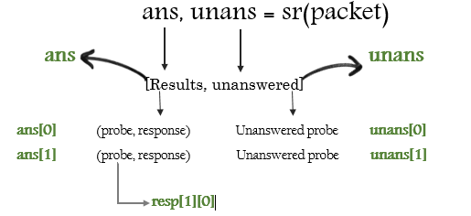
Hands on - SndRcvList & PacketList
sr() will return two kinds of list
  SndRcvList: Stores the packets we sent and the corresponding responses.
  PacketList: If there is any packet that doesn't get the response, it would be placed here.
Figure from “The Art of Packet Crafting with Scapy: Sending & recieving packets”

Slide 9
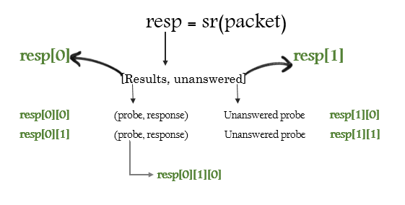
Hands on - Answered & Unanswered Packets

Slide 10
Hands on - rdpcap() & wrpcap()
rdpcap() | Read packets from pcap file.
wrpcap() | Save capture packets to pcap file.

Slide 11
Hands on - Common applications
Ping
  ICMP Echo Request
srloop(IP(dst="163.22.22.61")/ICMP(),count=4)
  ARP Ping
srp(Ether(dst="ff:ff:ff:ff:ff:ff")/ARP(pdst="10.22.149.0/24"), timeout=2)
    Scapy has built-in function for ARP Ping.
srloop() | Send a packet at layer 3 in loop and print the answer each time.
arping() | Performs similar to the above command.
Notes:
srloop(): Send a packet at layer 3 in loop and print the answer each time.
>>> srloop(IP(dst="163.22.22.61")/ICMP(),count=4)
>>> ans, unans = srp(Ether(dst="ff:ff:ff:ff:ff:ff")/ARP(pdst="10.22.149.0/24"), timeout=2)
arping()
>>> arping("10.22.149.0/24")
TCP Ping
>>> ans, unans = sr( IP(dst="10.22.149.0/24")/TCP(dport=80,flags="S") )

Slide 12
Hands on - Common applications
Traceroute
  ICMP
ans, unans = sr(IP(dst="8.8.8.8", ttl=(1,10))/ICMP())
for snd,rcv in ans:
print snd.ttl, rcv.src
  These tools use different protocols to traceroute:
  Scapy has built-in function for TCP traceroute.
Program | Protocol Used
Unix traceroute | UDP
Windows tracert | ICMP
Scapy traceroute() | TCP
Notes:
>>> ans, unans = sr(IP(dst="8.8.8.8", ttl=(1,10))/ICMP())
>>> for snd,rcv in ans:
. . . : print snd.ttl, rcv.src
traceroute():
>>> traceroute("8.8.8.8",maxttl=20)
The Art of Packet Crafting with Scapy - Traceroute: https://0xbharath.github.io/art-of-packet-crafting-with-scapy/network_recon/traceroute/index.html

Slide 13
Hands on - Common applications
Sniff
  Scapy has built-in function for capturing traffic.
sniff() | Returns a PacketList of the captured packets. | Parameters(optional): count, filter, iface, prn, timeout, etc.
AsyncSniffer() | Sniff asynchronously. Allows to stop the sniffer programmatically, rather than with ctrl+C. | Parameters(optional): The same as sniff(). Actions: start(), stop(), join(), results, etc.
Notes:
Filter for ICMP traffic to/from 10.99.1.32
>>> pktl = sniff(filter="icmp and host 10.99.1.32", count=10)
>>> pktl.nsummary()
Gives real time output like tcpdump.
>>> sniff(iface='ens160', prn=lambda x: x.summary(), count=1000)
prn allows you to pass a function that executes with each packet sniffed.
Filter for TCP port 80 traffic to/from 10.22.149.10
>>> sniff(filter="tcp and host 10.22.149.10 and port 80", count=1)
>>> send(IP(dst='10.22.149.10')/TCP()/"GET / HTTP/1.0\r\n\r\n")
Sniffs packets offline from pcap file.
>>> pkts = sniff(offline='Scapy/pcap/dnsq_client.pcap', filter="udp")
>>> wrpcap("Scapy/pcap/dnsq_udp.pcap",pkts)

Slide 14
Hands on - Common applications
DNS query
  What we need?
Layers | Classes | Parameters
Application Layer | DNS(), DNSQR() | DNS Question: QNAME, QTYPE.
Transport Layer | UDP() | Messages sent using UDP port 53.
Network Layer | IP(), IPv6() | DNS Server’s IP address.
Notes:
Send A record request via IPv4 packet
>>> dns = '163.22.22.65'
>>> dnsq = IP(dst=dns)/UDP(dport=53)/DNS(qd=DNSQR(qname="iperf.pearl.ncnu.org", qtype="A"))
>>> sr1(dnsq)
Send AAAA record request via IPv6 packet
>>> dns6 = '2001:4860:4860::8888'
>>> dnsq6 = IPv6(dst=dns6)/UDP(dport=53)/DNS(qd=DNSQR(qname="www.google.com", qtype="AAAA"))
>>> sr1(dnsq6)
DNS traceroute
>>> ans, unans = traceroute("8.8.8.8",l4=UDP(sport=RandShort())/DNS(qd=DNSQR(qname="www.google.com")))

Slide 15
References
Scapy’s official website: https://scapy.net/
Scapy’s GitHub: https://github.com/secdev/scapy
Scapy’s Documentation: https://scapy.readthedocs.io/en/latest/index.html
Other learning materials I think are helpful:
  “GeeksforGeeks”
Most of you must know this website. :)
https://www.geeksforgeeks.org/scapy-packet-manipulation-in-kali-linux/?ref=gcse
  “The Art of Packet Crafting with Scapy”
A note written by a workshop.
https://0xbharath.github.io/art-of-packet-crafting-with-scapy/index.html
  “thePacketGeek”
The author's name is Mat Wood. He also wrote a note for PyShark.
https://thepacketgeek.com/scapy/

